Slide 1
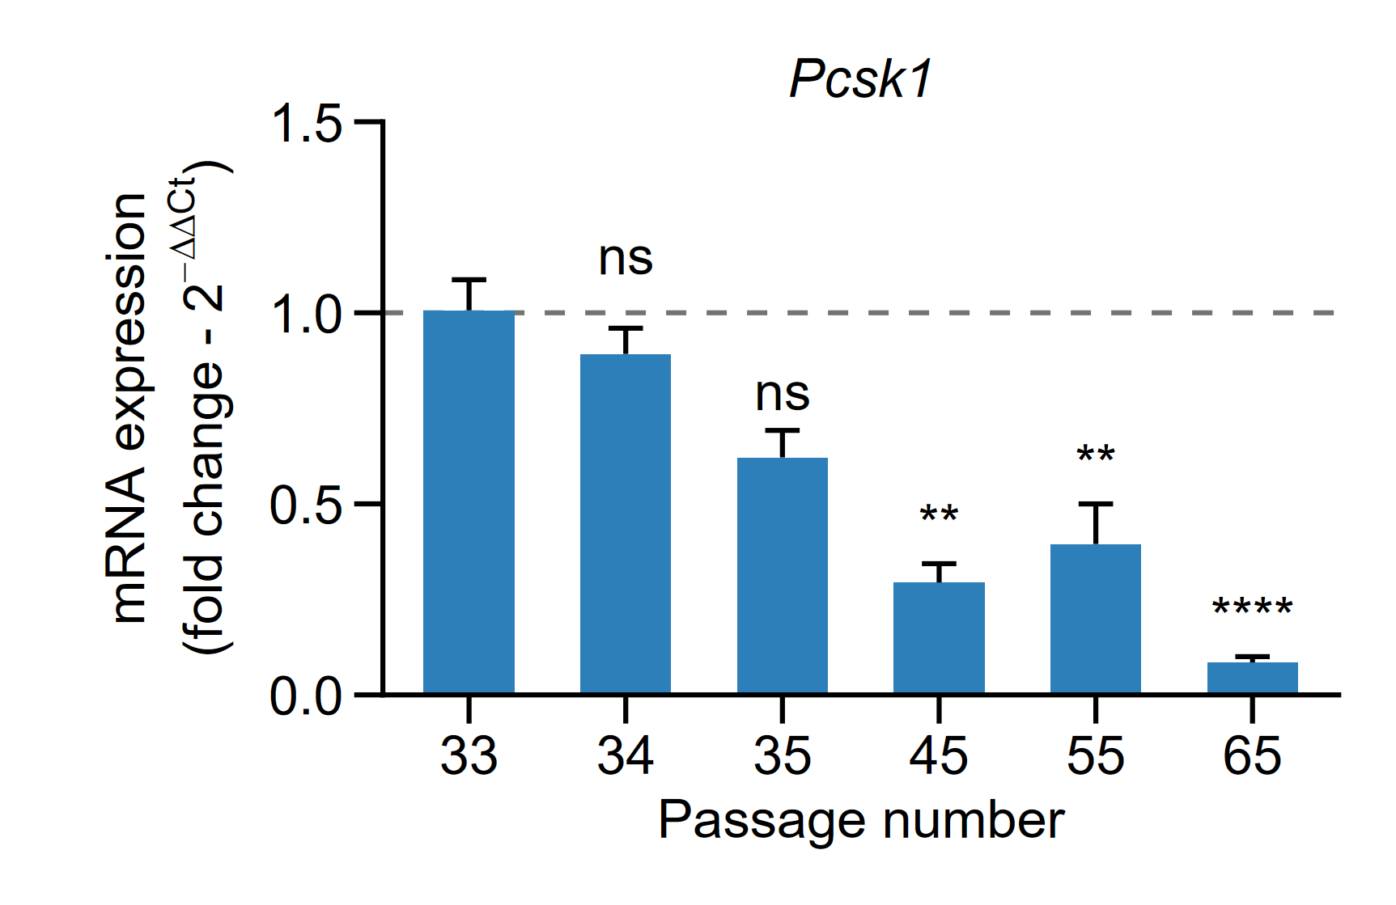
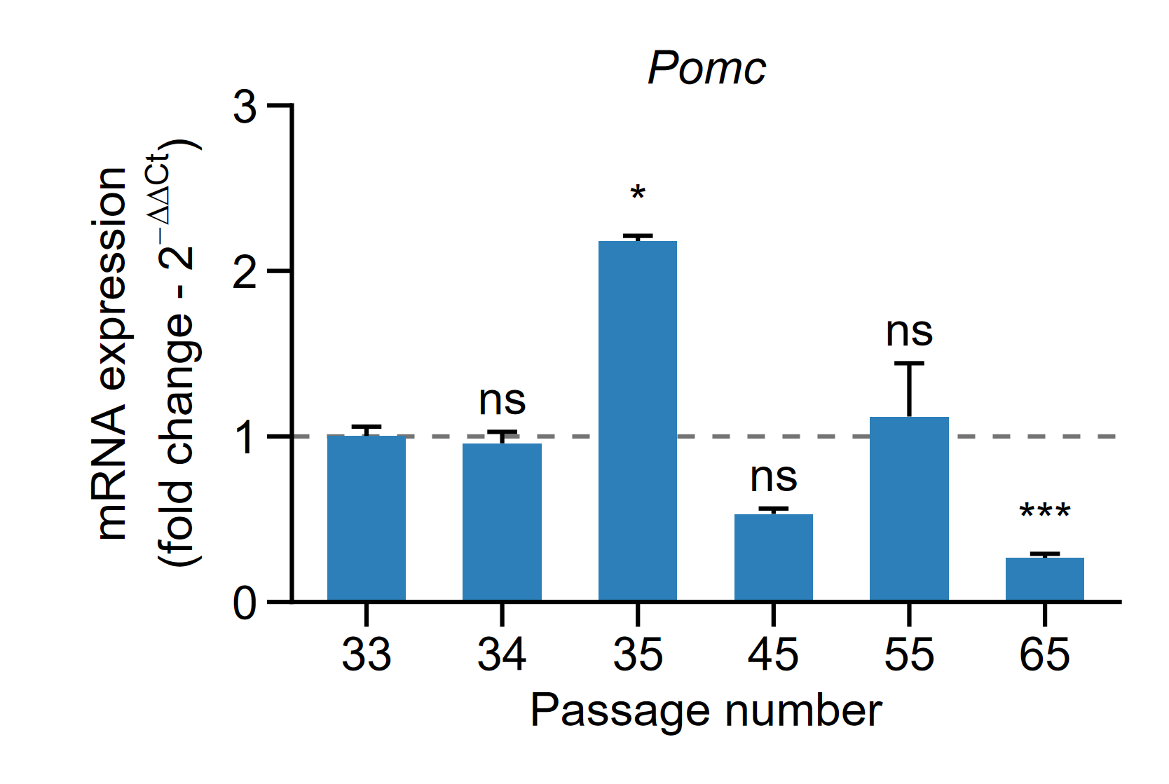
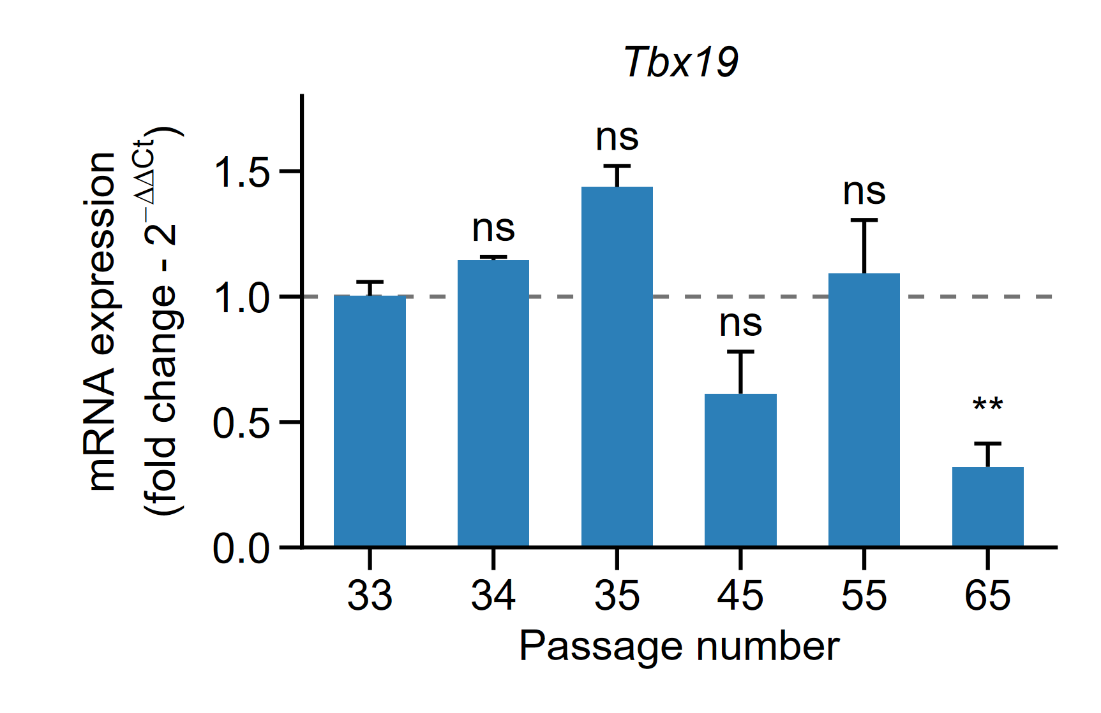
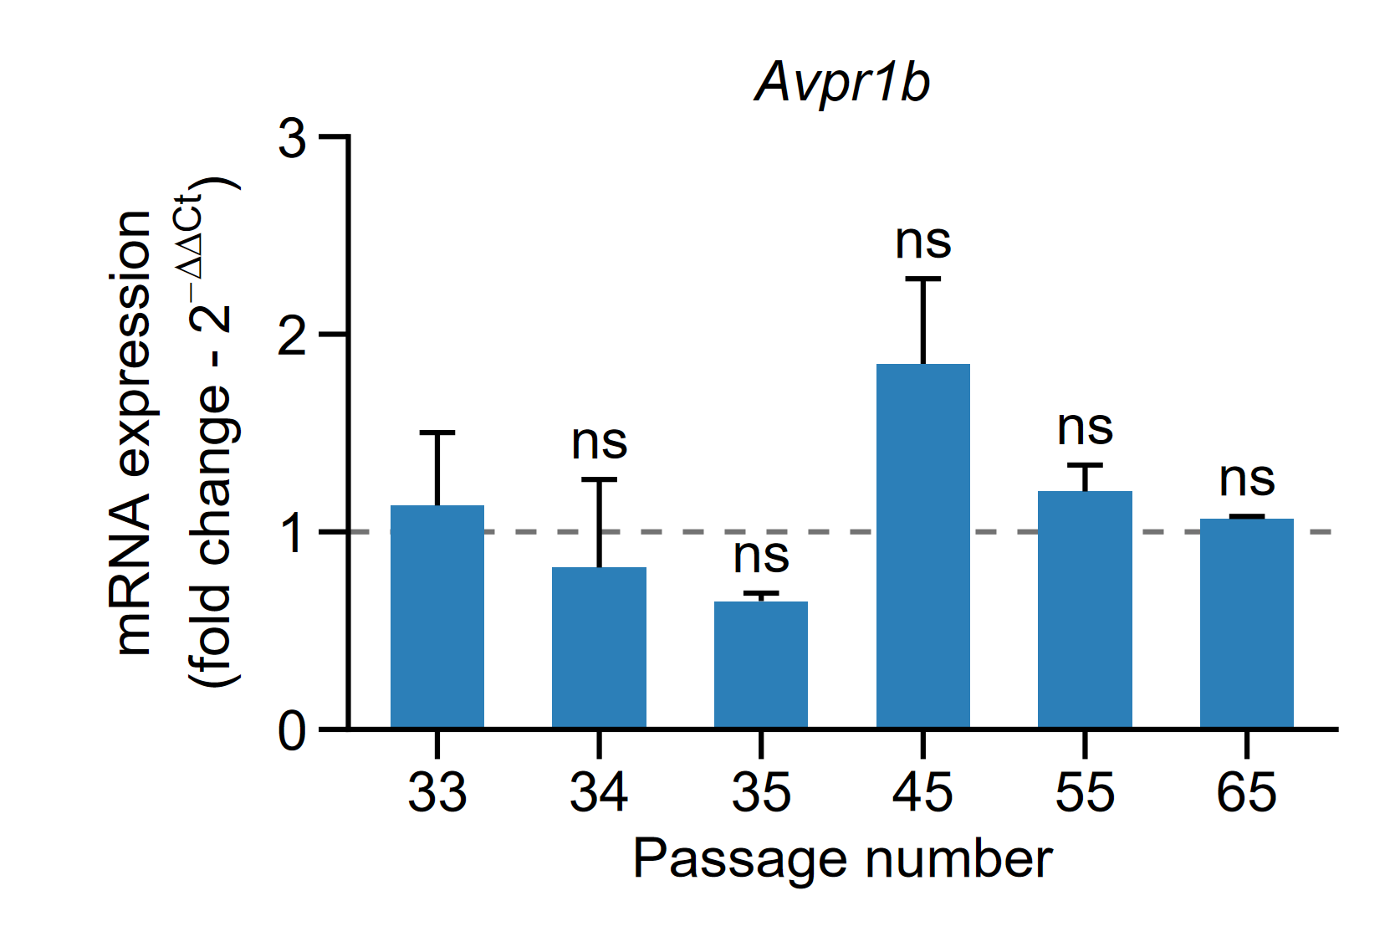
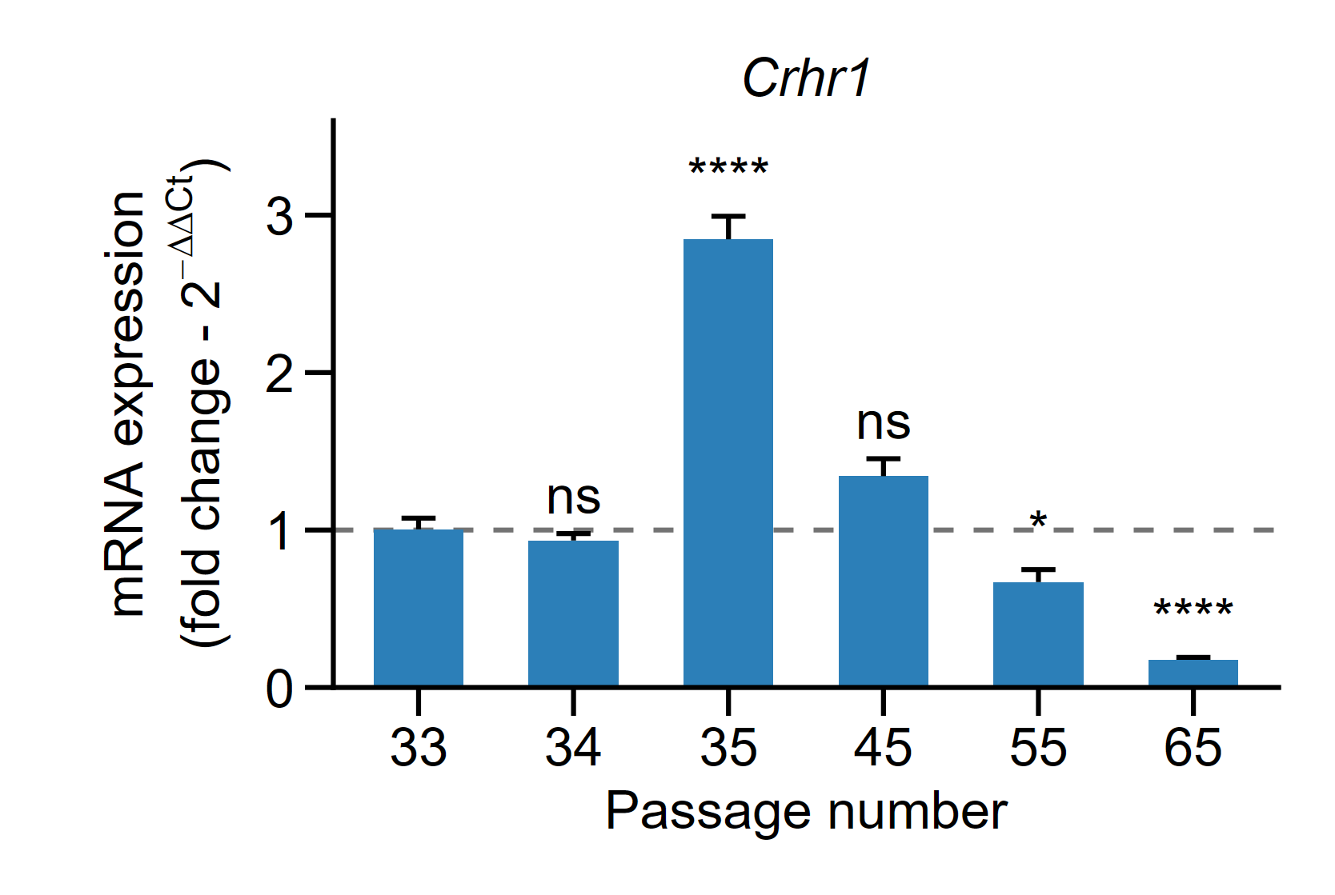
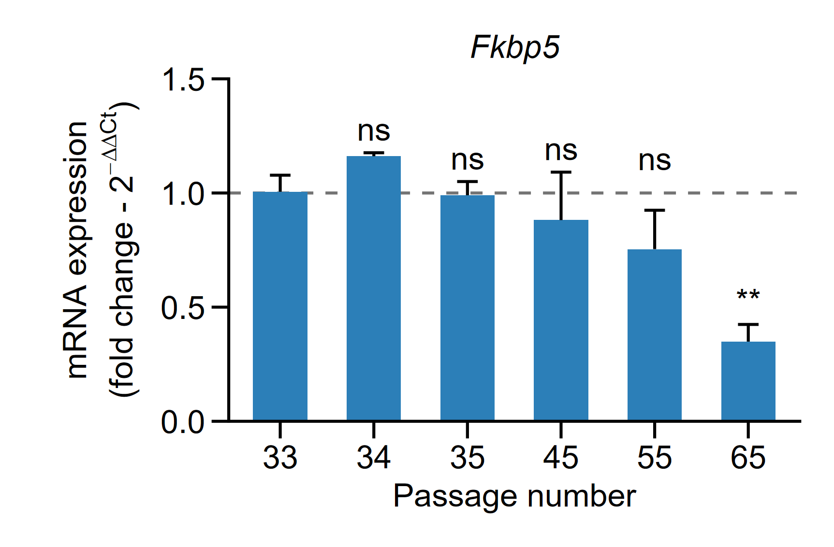
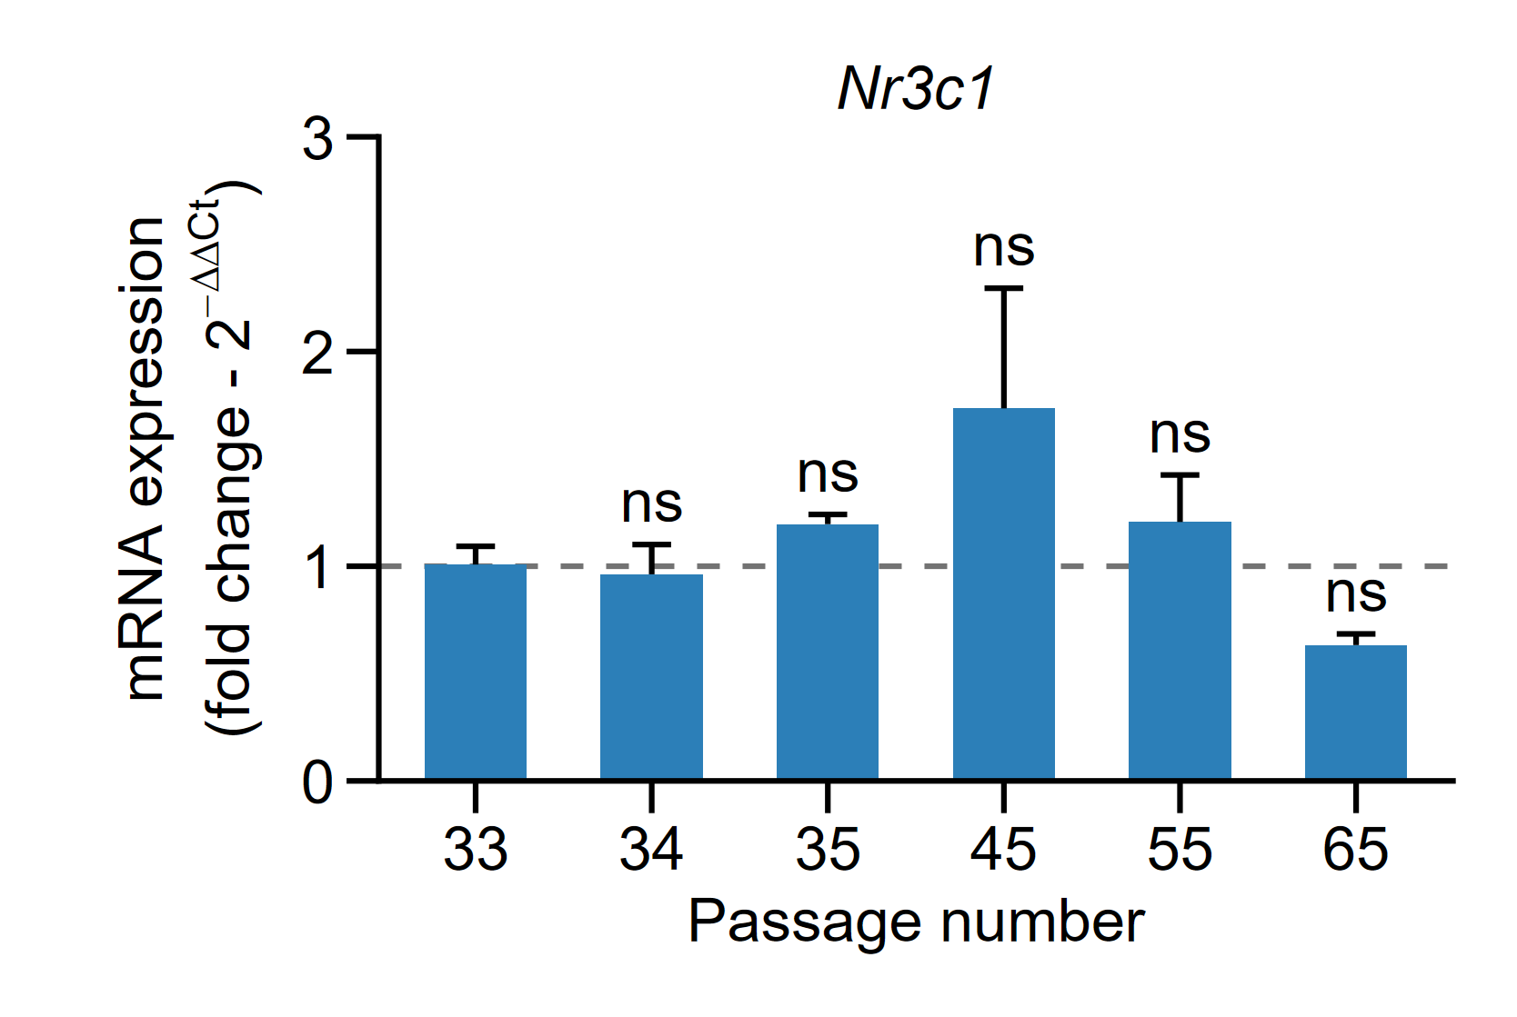
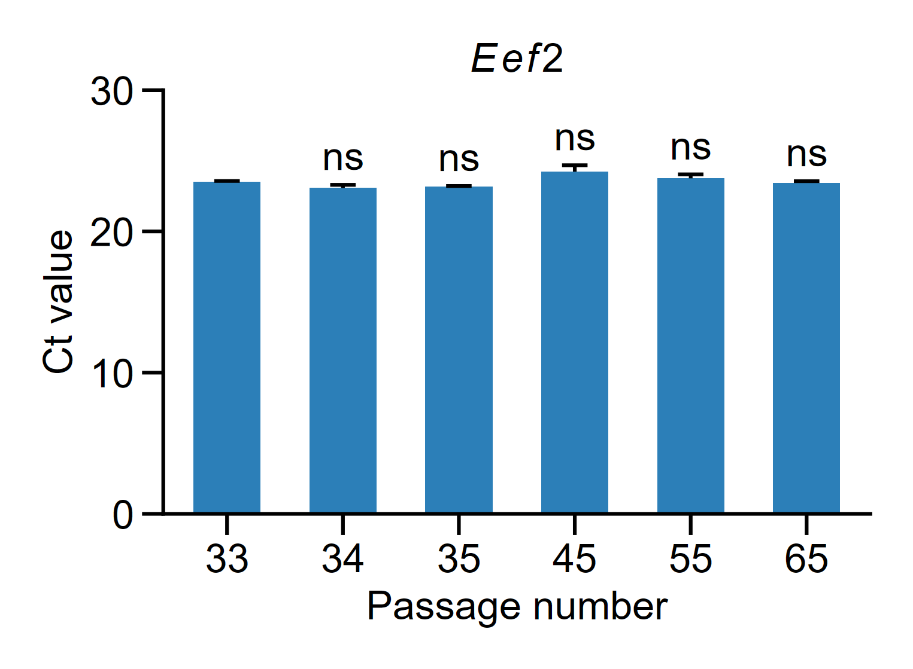
Caracterización génica AtT-20
18-08-2026
Figure X. Passage-dependent changes in gene expression in AtT-20 cells. Relative mRNA expression of Pcsk1, Pomc, Tbx19, Avpr1b, Crhr1, Fkbp5, and Nr3c1 was determined by RT-qPCR in AtT-20 cells at passages 33, 34, 35, 45, 55, and 65. Gene expression was normalized to Eef2 and calculated using the 2^−ΔΔCt method, with passage 33 used as the calibrator (fold change = 1; dashed line). Data are presented as mean ± SEM (n = 3 independent pools per passage). Statistical analyses were performed on ΔCt values using one-way ANOVA followed by Dunnett’s multiple-comparison test, with passage 33 as the reference group. ns, not significant; p < 0.05 (); p < 0.01 (); p < 0.001 (); p < 0.0001 (****).
Figure X. Eef2 expression stability across AtT-20 cell passages. Ct values of Eef2 were evaluated in AtT-20 cells at passages 33, 34, 35, 45, 55, and 65. Data are presented as mean ± SEM (n = 3 pools per passage). Differences among passages were assessed using a linear mixed-effects model, including passage and plate as fixed effects and sample as a random effect. The overall effect of passage was not statistically significant (F(5,12) = 3.004, p = 0.0550). Post hoc Dunnett’s multiple-comparison test, using passage 33 as the reference, detected no significant differences at any passage. ns, not significant (adjusted p > 0.05).

Slide 2
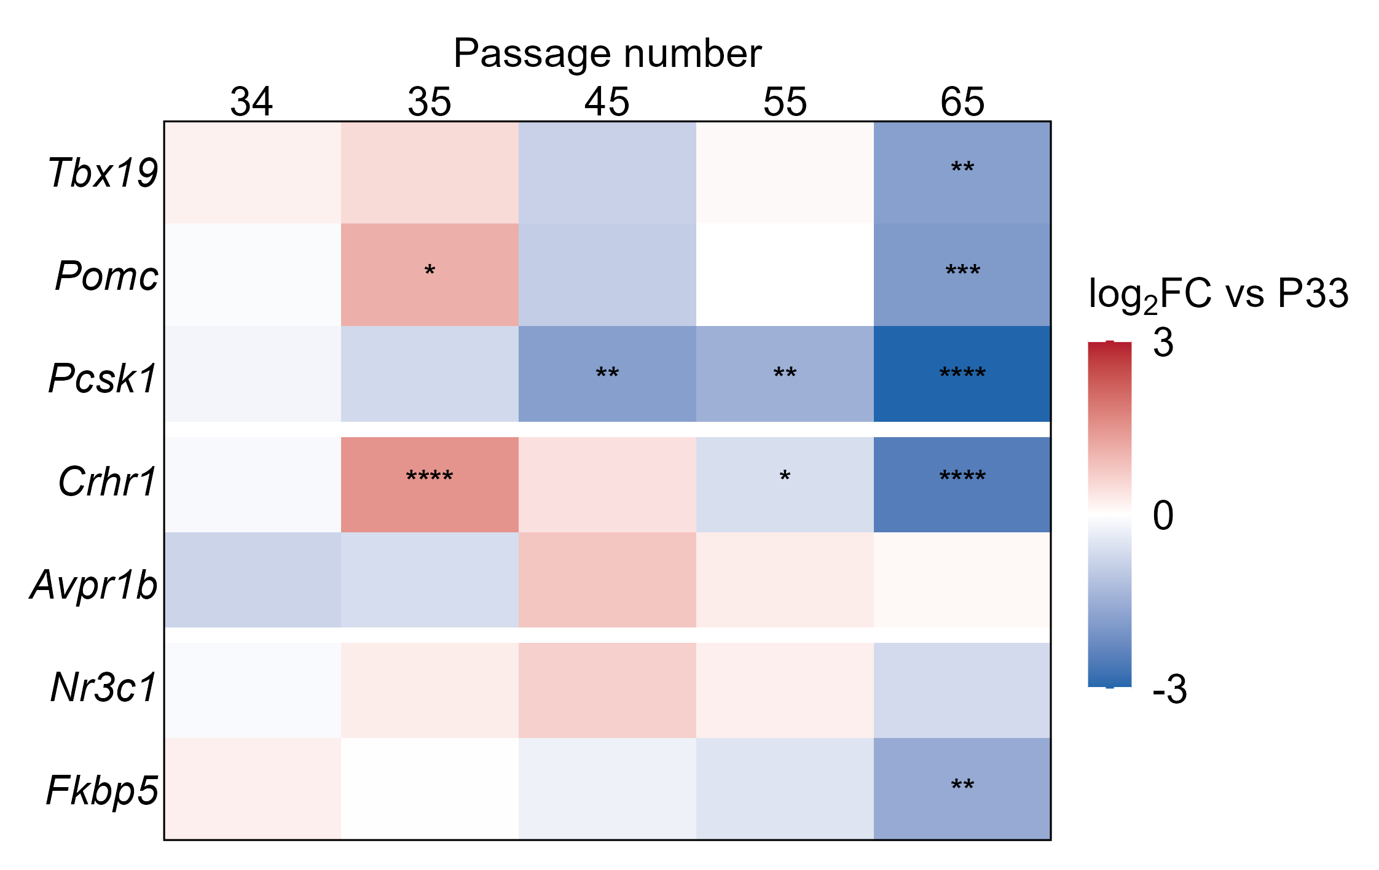
Caracterización génica AtT-20
18-08-2026
Figure X. Passage-dependent changes in basal gene expression in AtT-20 cells. Heatmap showing log2 fold changes (log2FC) in basal mRNA expression at passages 34, 35, 45, 55, and 65 relative to passage 33 (P33), used as the reference condition. Expression of each target gene was normalized to Eef2. Statistical analyses were performed on ΔCt values using one-way ANOVA followed by Dunnett’s multiple-comparison test versus P33. Only statistically significant comparisons are indicated within the corresponding cells (P < 0.05, P < 0.01, P < 0.001, P < 0.0001). Genes are arranged according to functional groups related to corticotroph identity and function (Tbx19, Pomc, Pcsk1), upstream signaling (Crhr1, Avpr1b), and glucocorticoid signaling (Nr3c1, Fkbp5). Red and blue indicate increased and decreased expression relative to P33, respectively, whereas white indicates little or no change. The color scale was capped at ±3 log2FC for visualization; values exceeding these limits were saturated at the corresponding color extreme without altering the underlying numerical values.

Slide 3
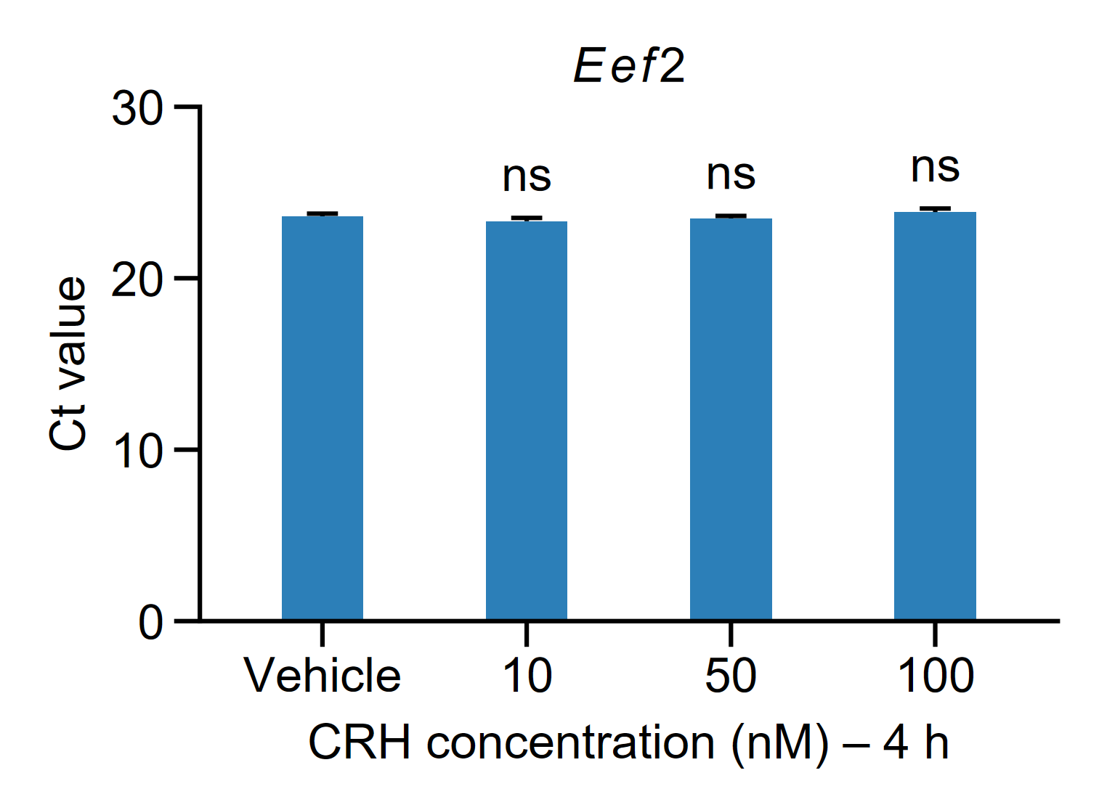
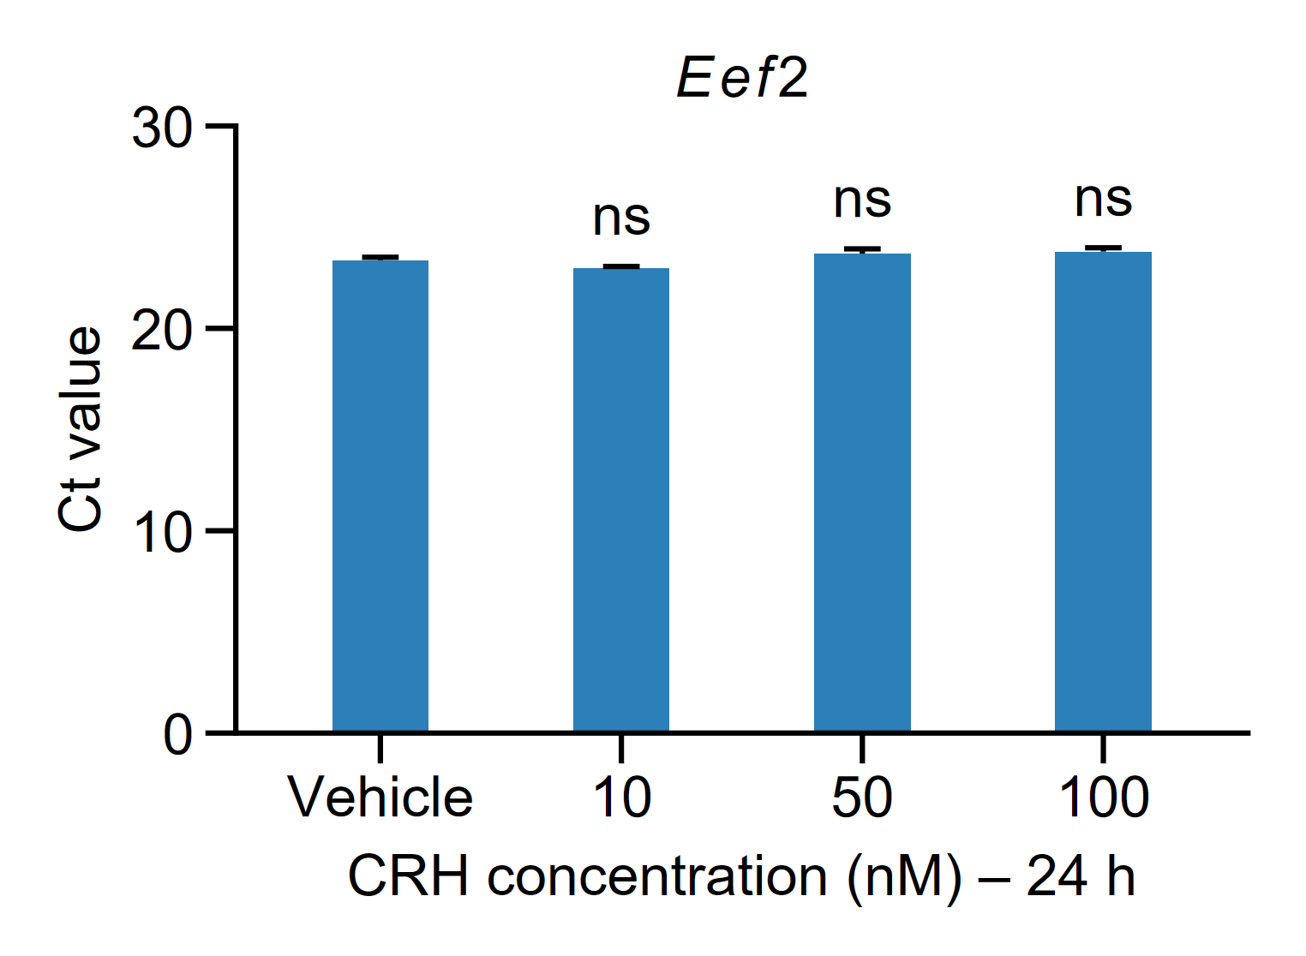
Prueba Concentraciones CRH
18-08-2026
Figure X. Stability of Eef2 Ct values in AtT-20 cells following CRH treatment. AtT-20 cells were exposed to vehicle or CRH at 10, 50, or 100 nM for 4 h or 24 h. Bars represent mean Ct values ± SEM. Statistical analyses were performed separately for each time point using a linear model including CRH concentration and biological replicate, followed by Dunnett-adjusted comparisons of each CRH concentration versus vehicle. Statistical significance is indicated for each comparison; ns, not significant.6

Slide 4
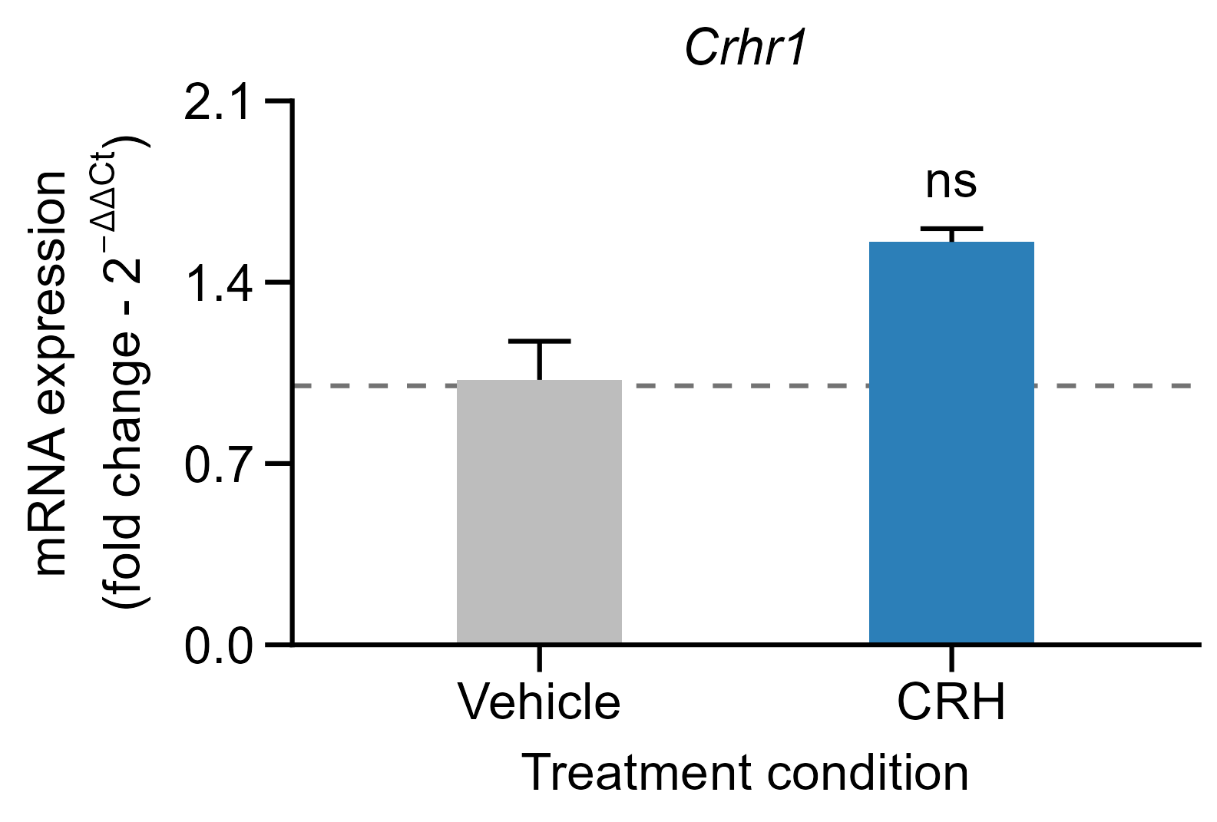
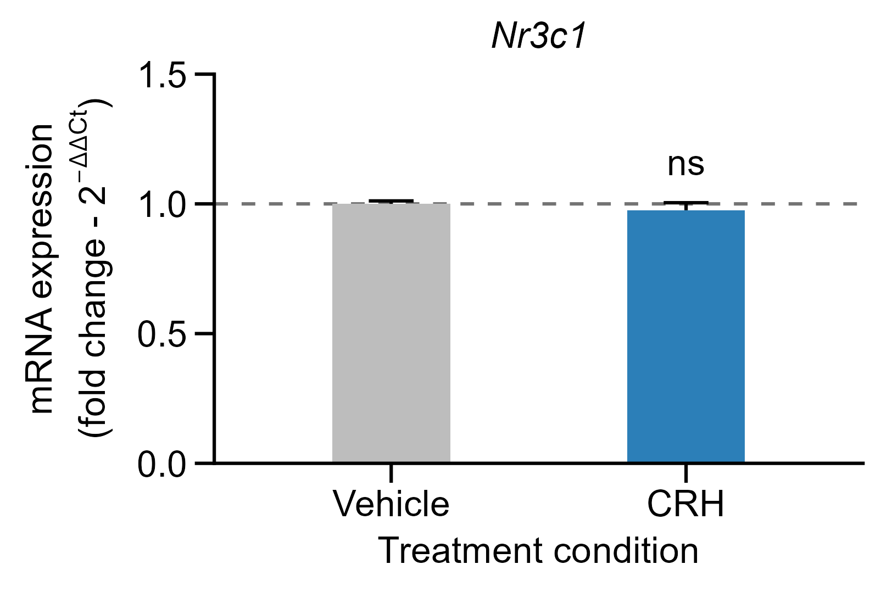
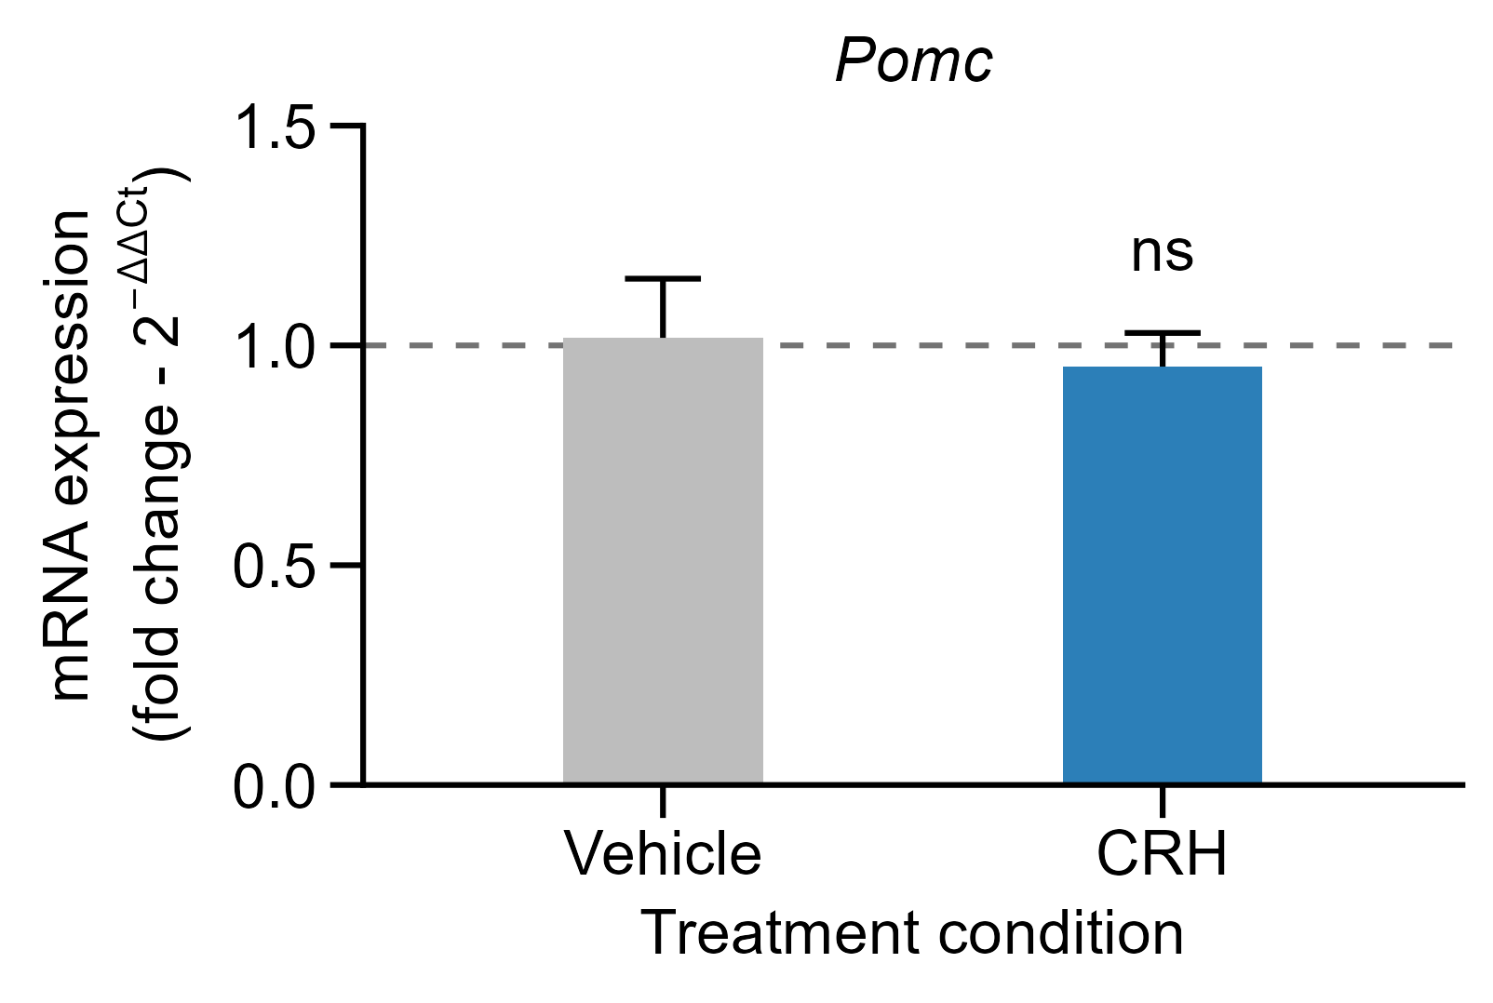
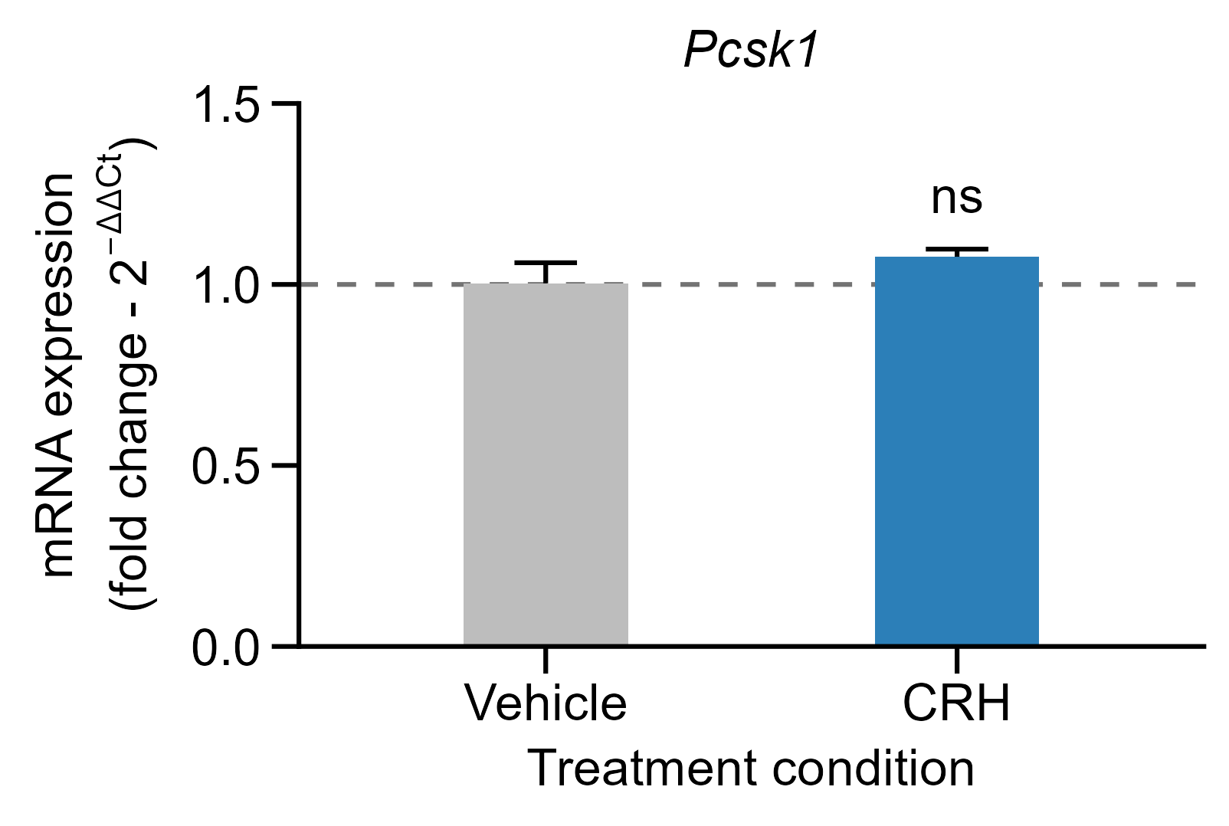

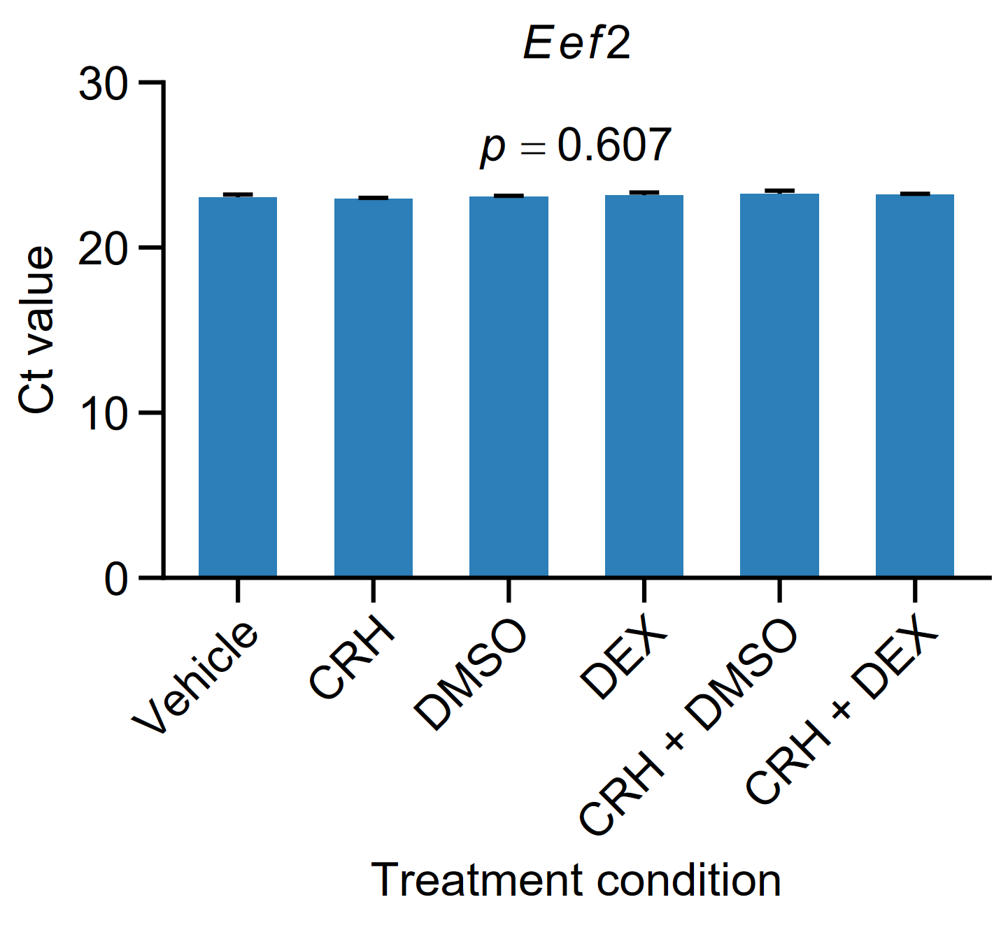
Exp.1 Validación farmacológica CRH
18-08-2026
Figure X. Effect of CRH treatment on corticotroph-related gene expression in AtT-20 cells.
Relative mRNA expression of (A) Crhr1, (B) Fkbp5, (C) Nr3c1, (D) Pcsk1, and (E) Pomc was evaluated in AtT-20 cells following treatment with CRH (10 nM) for 24 h. Gene expression was normalized to Eef2 and calculated using the 2^−ΔΔCt method, with vehicle-treated cells used as the calibrator (fold change = 1; dashed line). Data are presented as mean ± SEM (n = 3 independent biological replicates per condition). Statistical analyses were performed on ΔCt values using a linear model including treatment and biological replicate as factors, followed by type II ANOVA. No significant differences were detected between vehicle- and CRH-treated cells for Crhr1 (p = 0.1281), Fkbp5 (p = 0.2469), Nr3c1 (p = 0.3843), Pcsk1 (p = 0.2492), or Pomc (p = 0.6009). ns, not significant.
Figure X. Stability of Eef2 expression in AtT-20 cells treated with CRH and dexamethasone.
Eef2 Ct values were determined in AtT-20 cells treated with vehicle, CRH (10 nM), DMSO, dexamethasone (DEX; 100 nM), CRH + DMSO, or CRH + DEX. Data are presented as mean ± SEM (n = 3 independent biological replicates per condition). The overall effect of treatment was assessed using a linear model with biological replicate included as a blocking factor, followed by type II ANOVA. No significant differences were detected among treatment conditions (p = 0.6067).

Slide 5
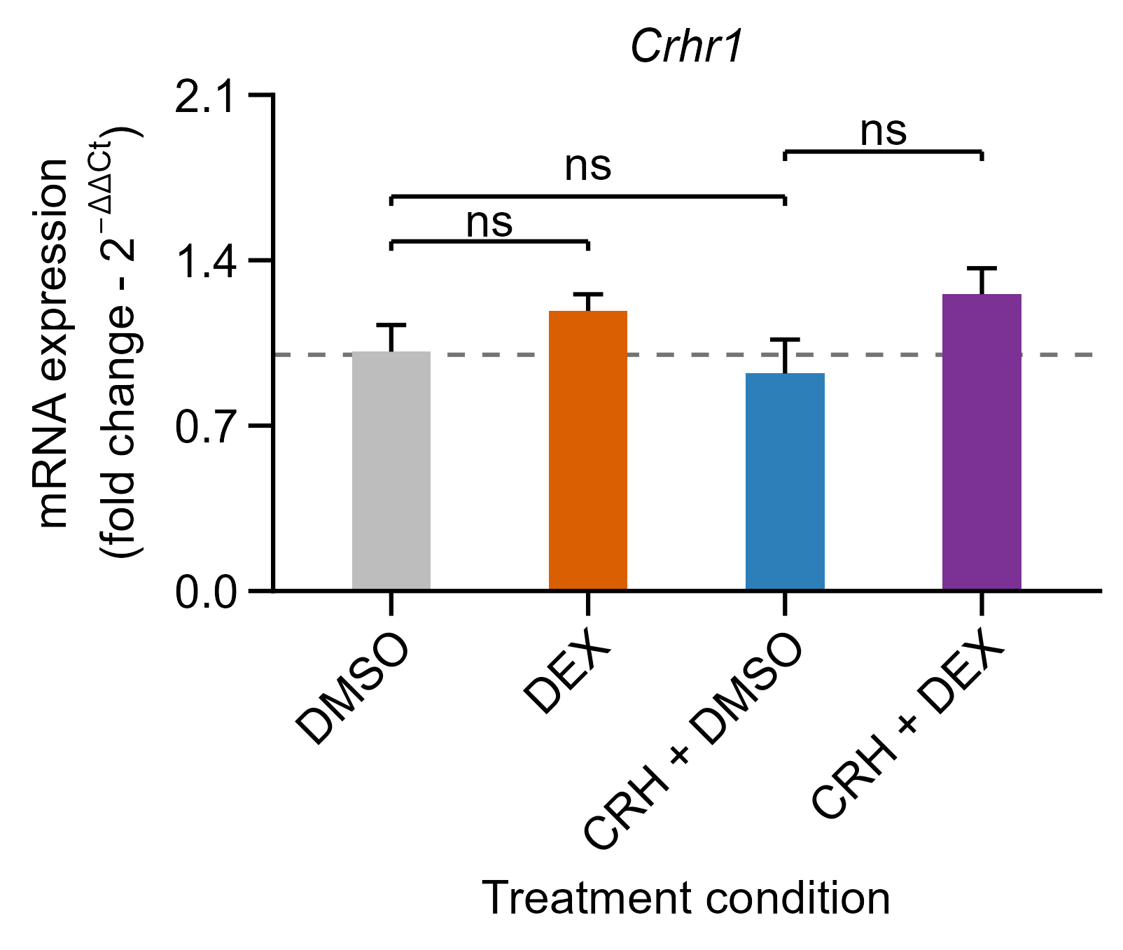
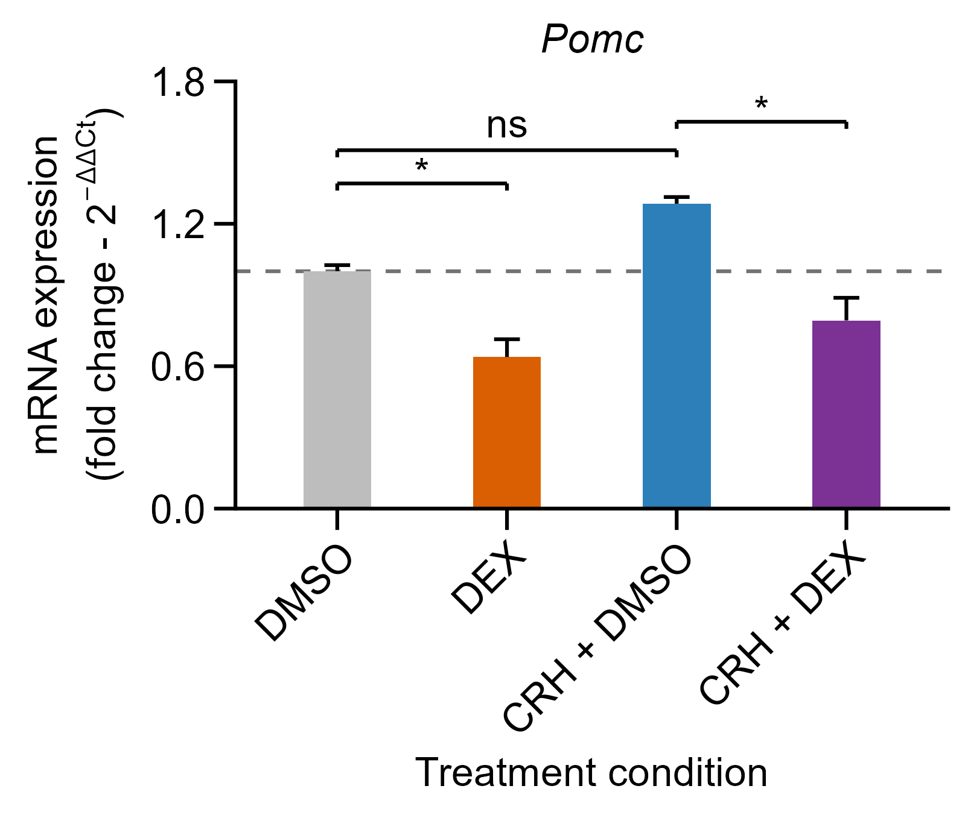
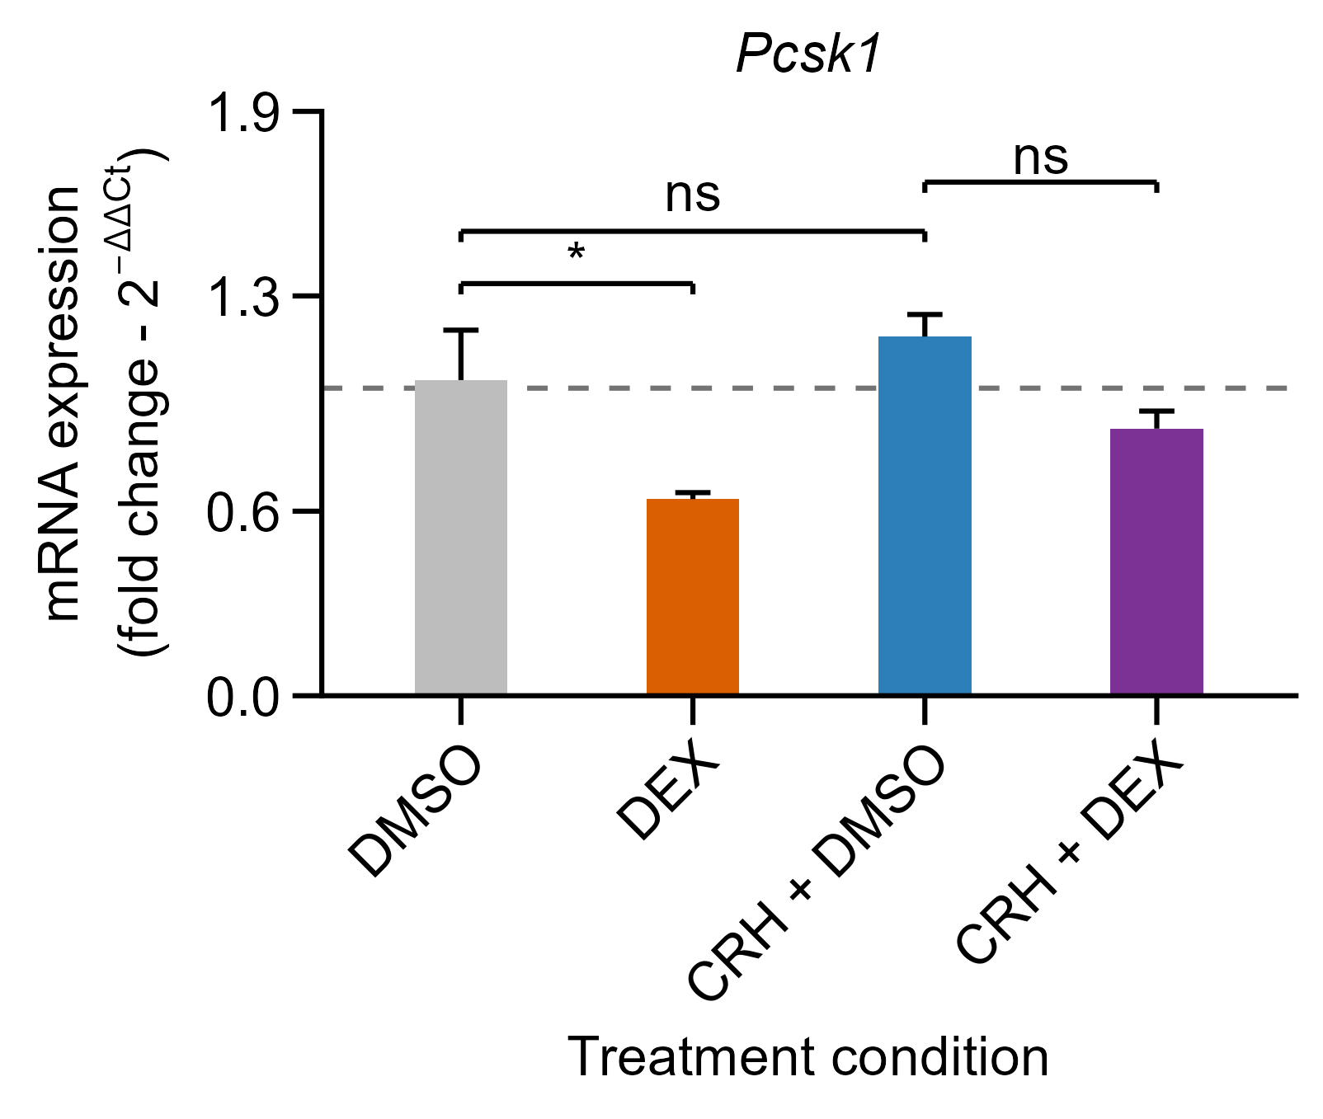
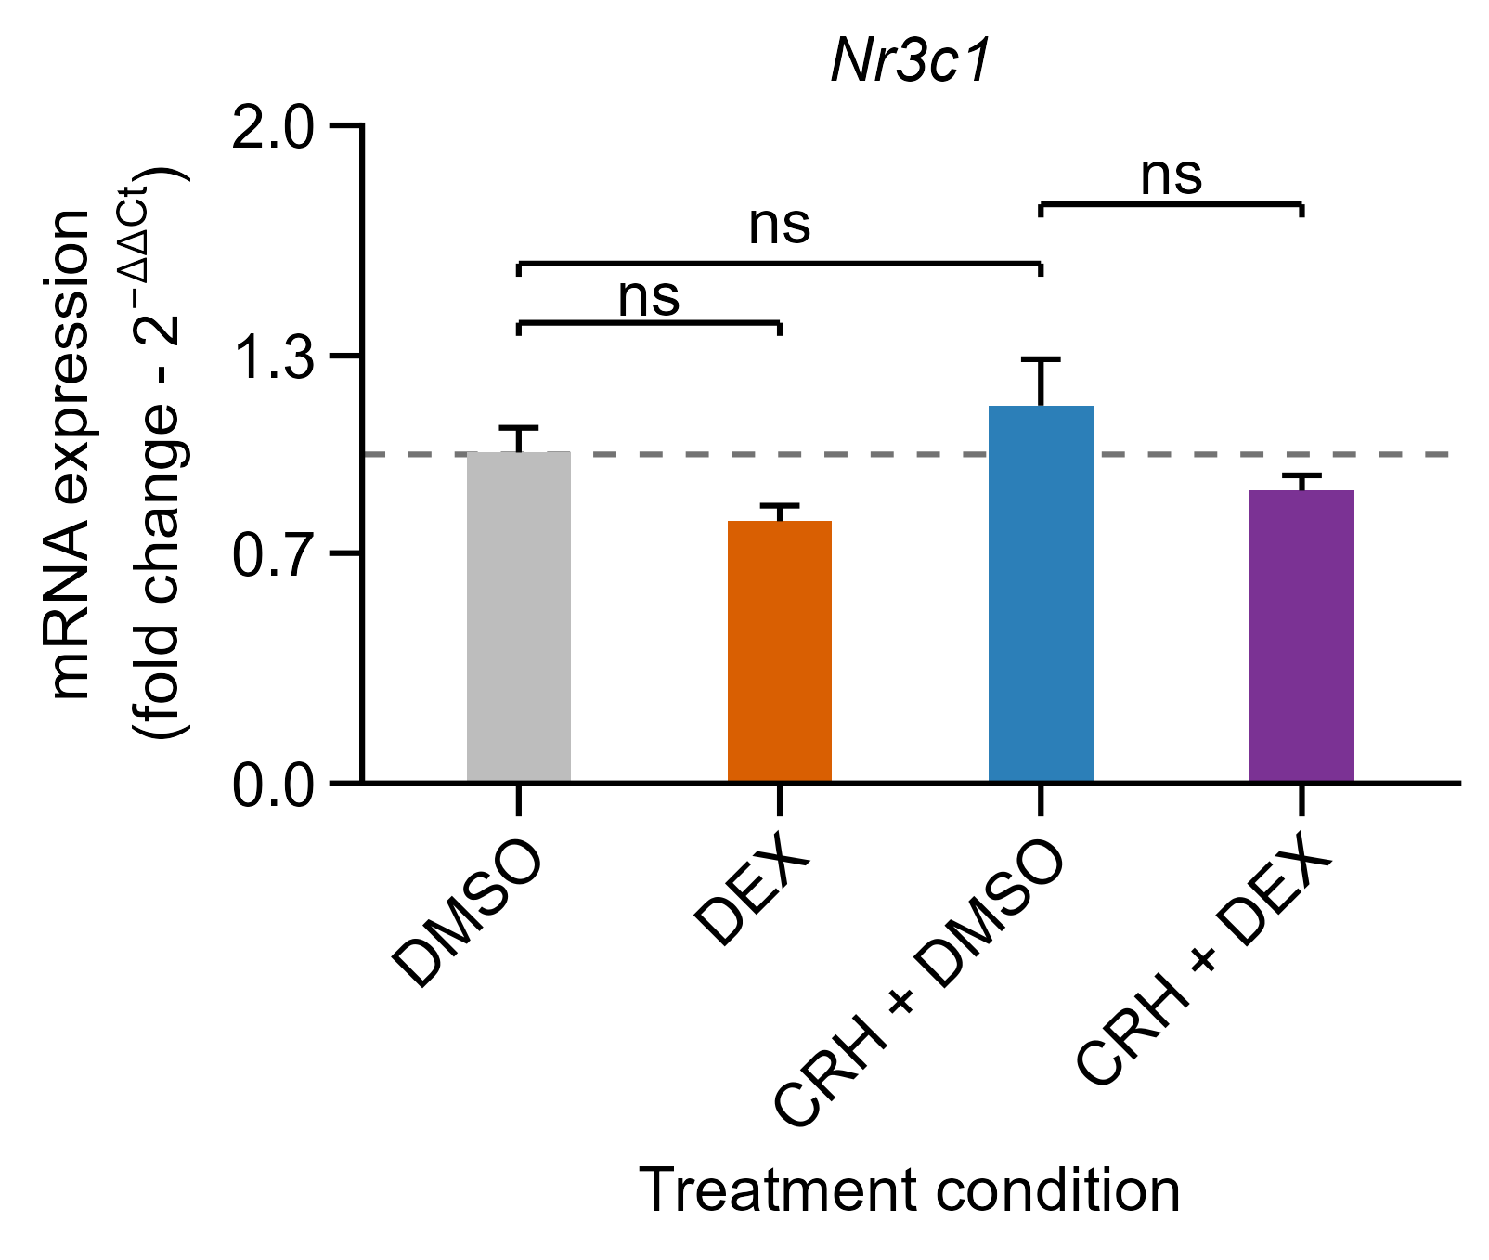
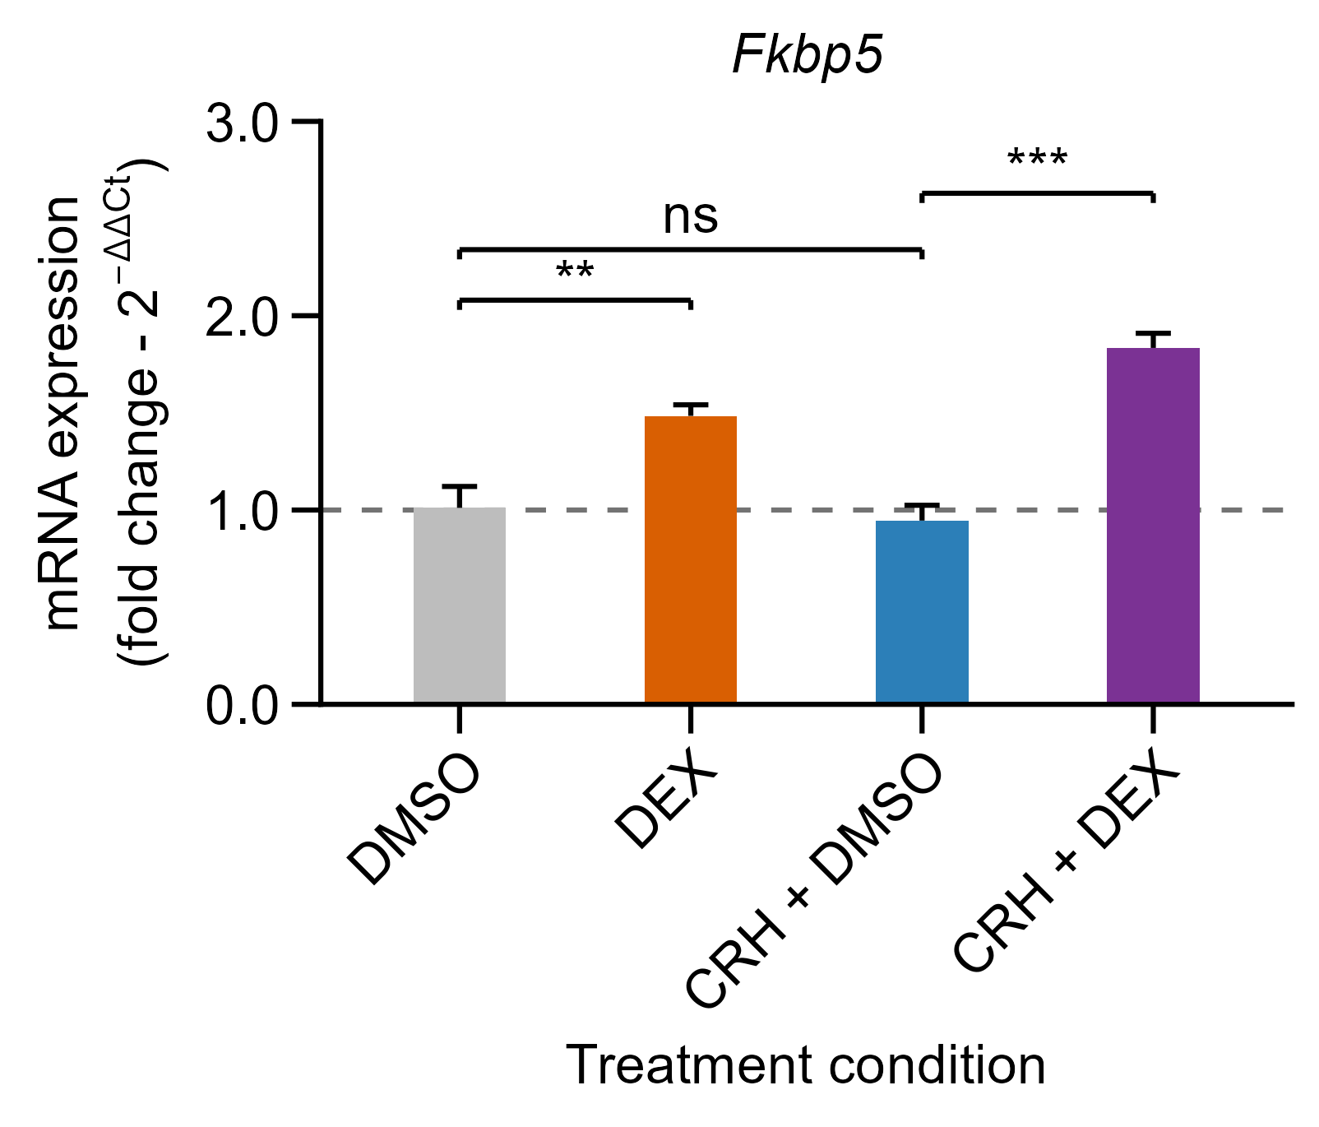
Exp.1 Validación farmacológica dexametasona
18-08-2026
Figure X. Effects of CRH and dexamethasone on corticotroph-related gene expression in AtT-20 cells.
Relative mRNA expression of (A) Crhr1, (B) Fkbp5, (C) Nr3c1, (D) Pcsk1, and (E) Pomc was evaluated in AtT-20 cells after 24 h of treatment with DMSO, dexamethasone (DEX; 100 nM), CRH (10 nM) + DMSO, or CRH (10 nM) + DEX (100 nM). Gene expression was normalized to Eef2 and calculated using the 2^−ΔΔCt method, with DMSO as the calibrator. Data are presented as mean ± SEM (n = 3 independent biological replicates per condition). Statistical analyses were performed on ΔCt values using a factorial linear model including CRH, DEX, their interaction, and biological replicate as a blocking factor, followed by type III ANOVA. Prespecified pairwise comparisons were adjusted using the Holm method. ns, not significant; p < 0.05; *p < 0.01; **p < 0.001
Figure X. Stability of Eef2 expression in AtT-20 cells treated with CRH and dexamethasone.
Eef2 Ct values were determined in AtT-20 cells treated with vehicle, CRH (10 nM), DMSO, dexamethasone (DEX; 100 nM), CRH + DMSO, or CRH + DEX. Data are presented as mean ± SEM (n = 3 independent biological replicates per condition). The overall effect of treatment was assessed using a linear model with biological replicate included as a blocking factor, followed by type II ANOVA. No significant differences were detected among treatment conditions (p = 0.6067).

Slide 6
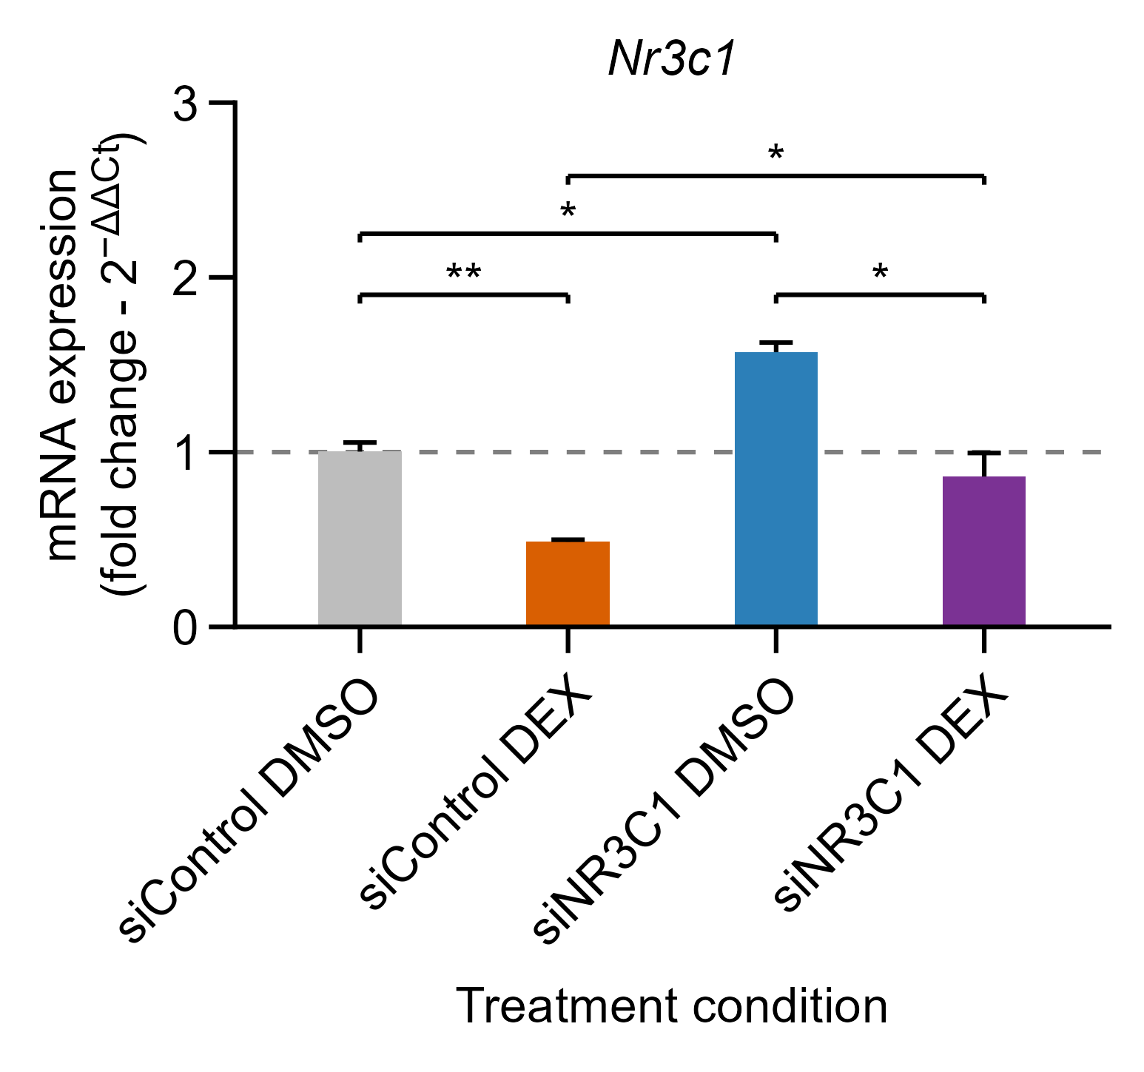
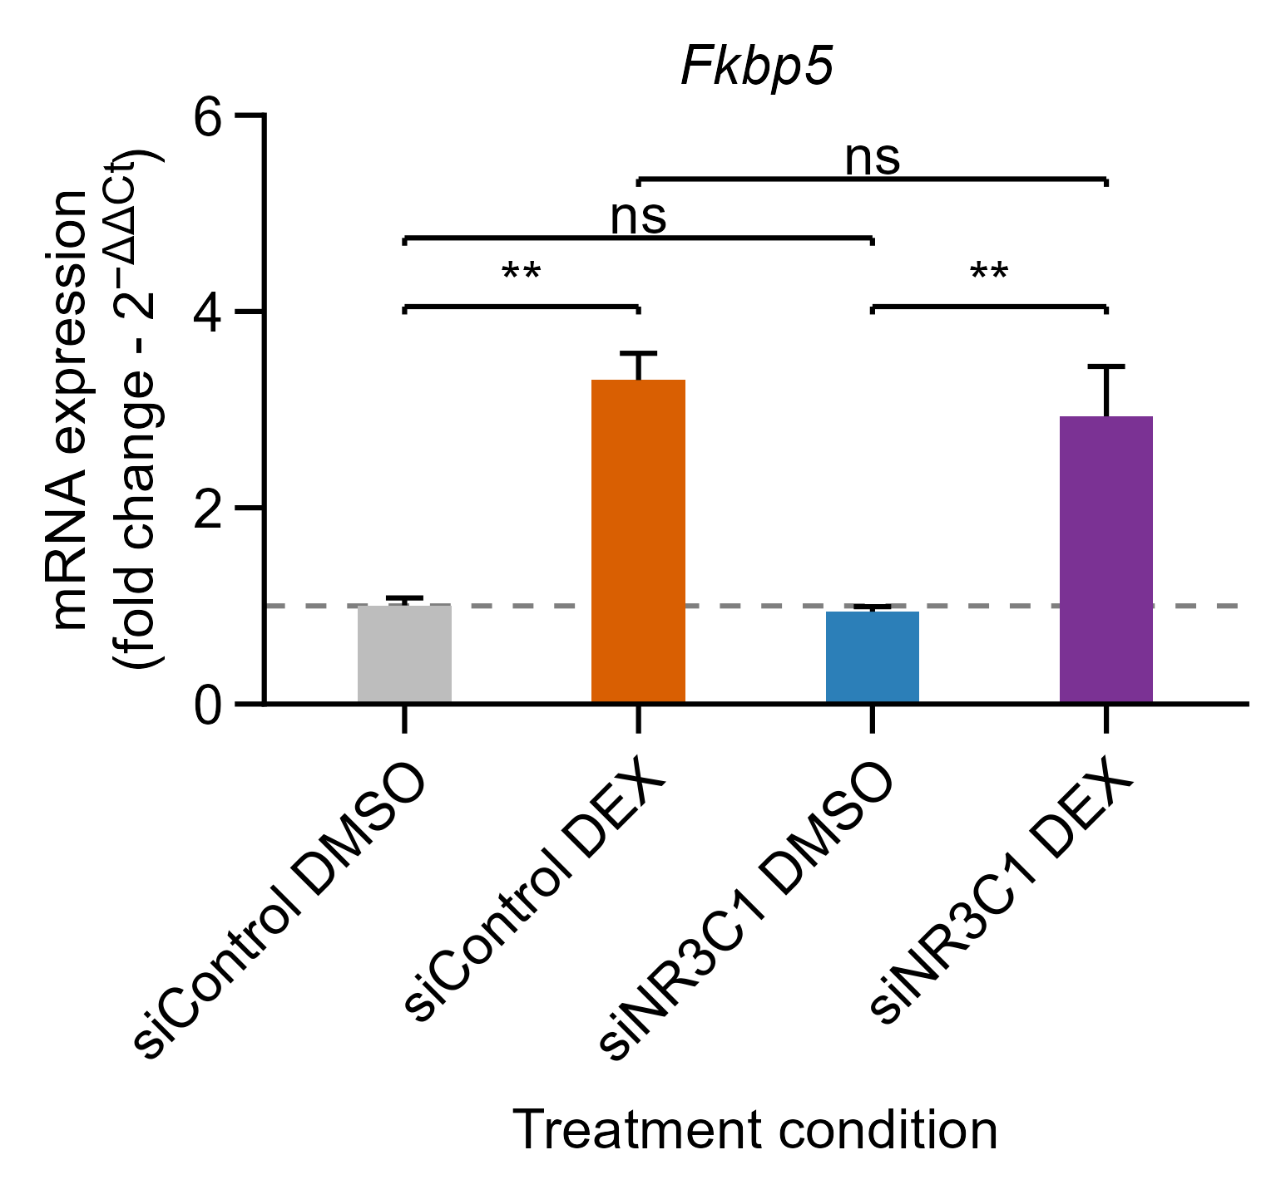
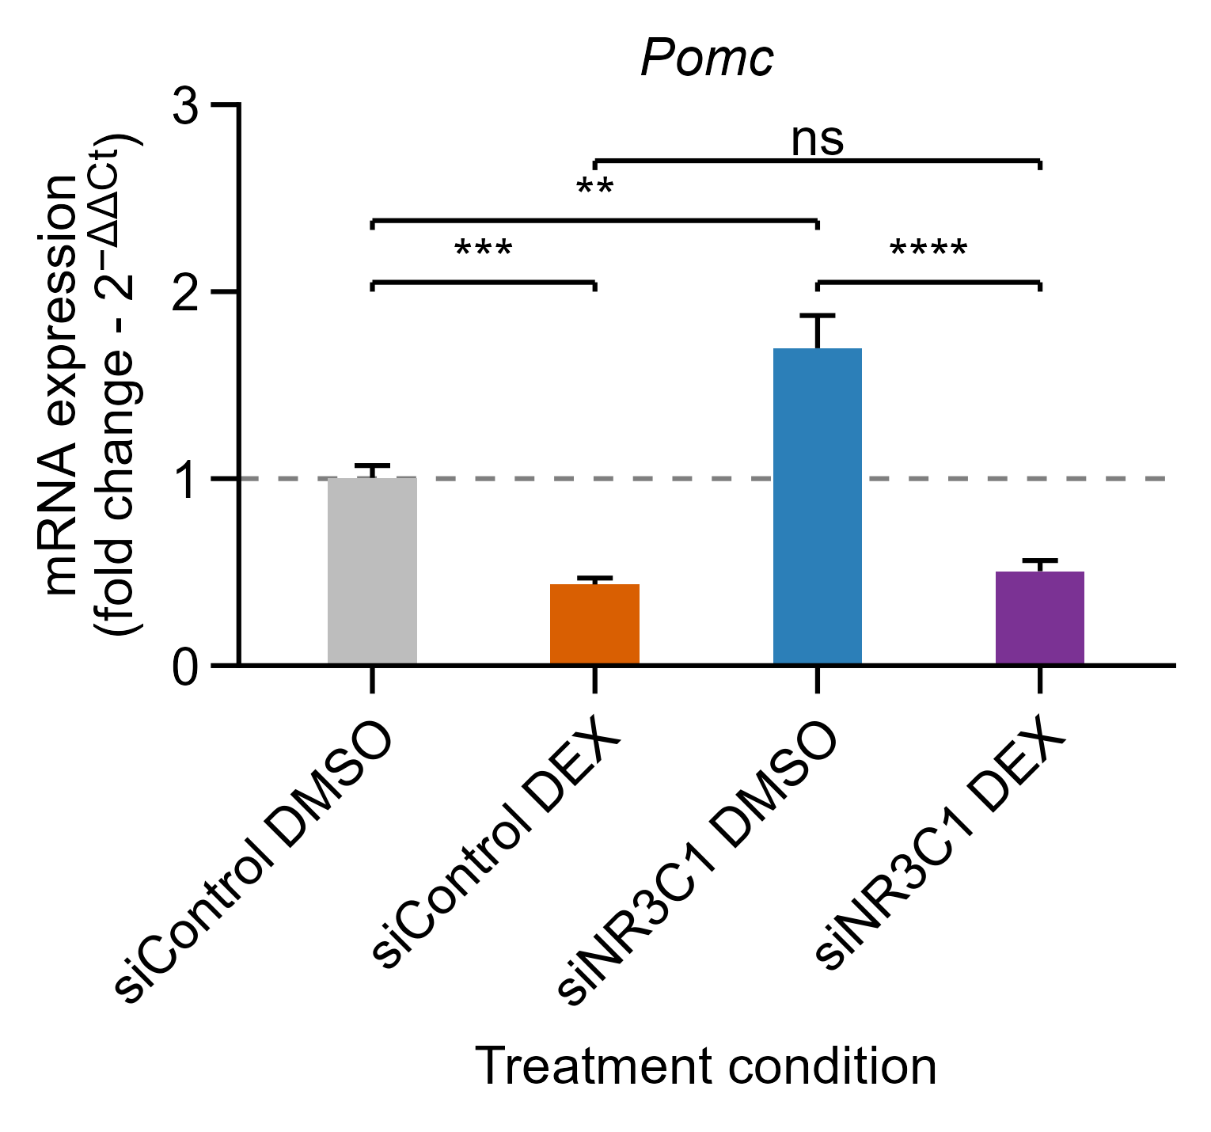
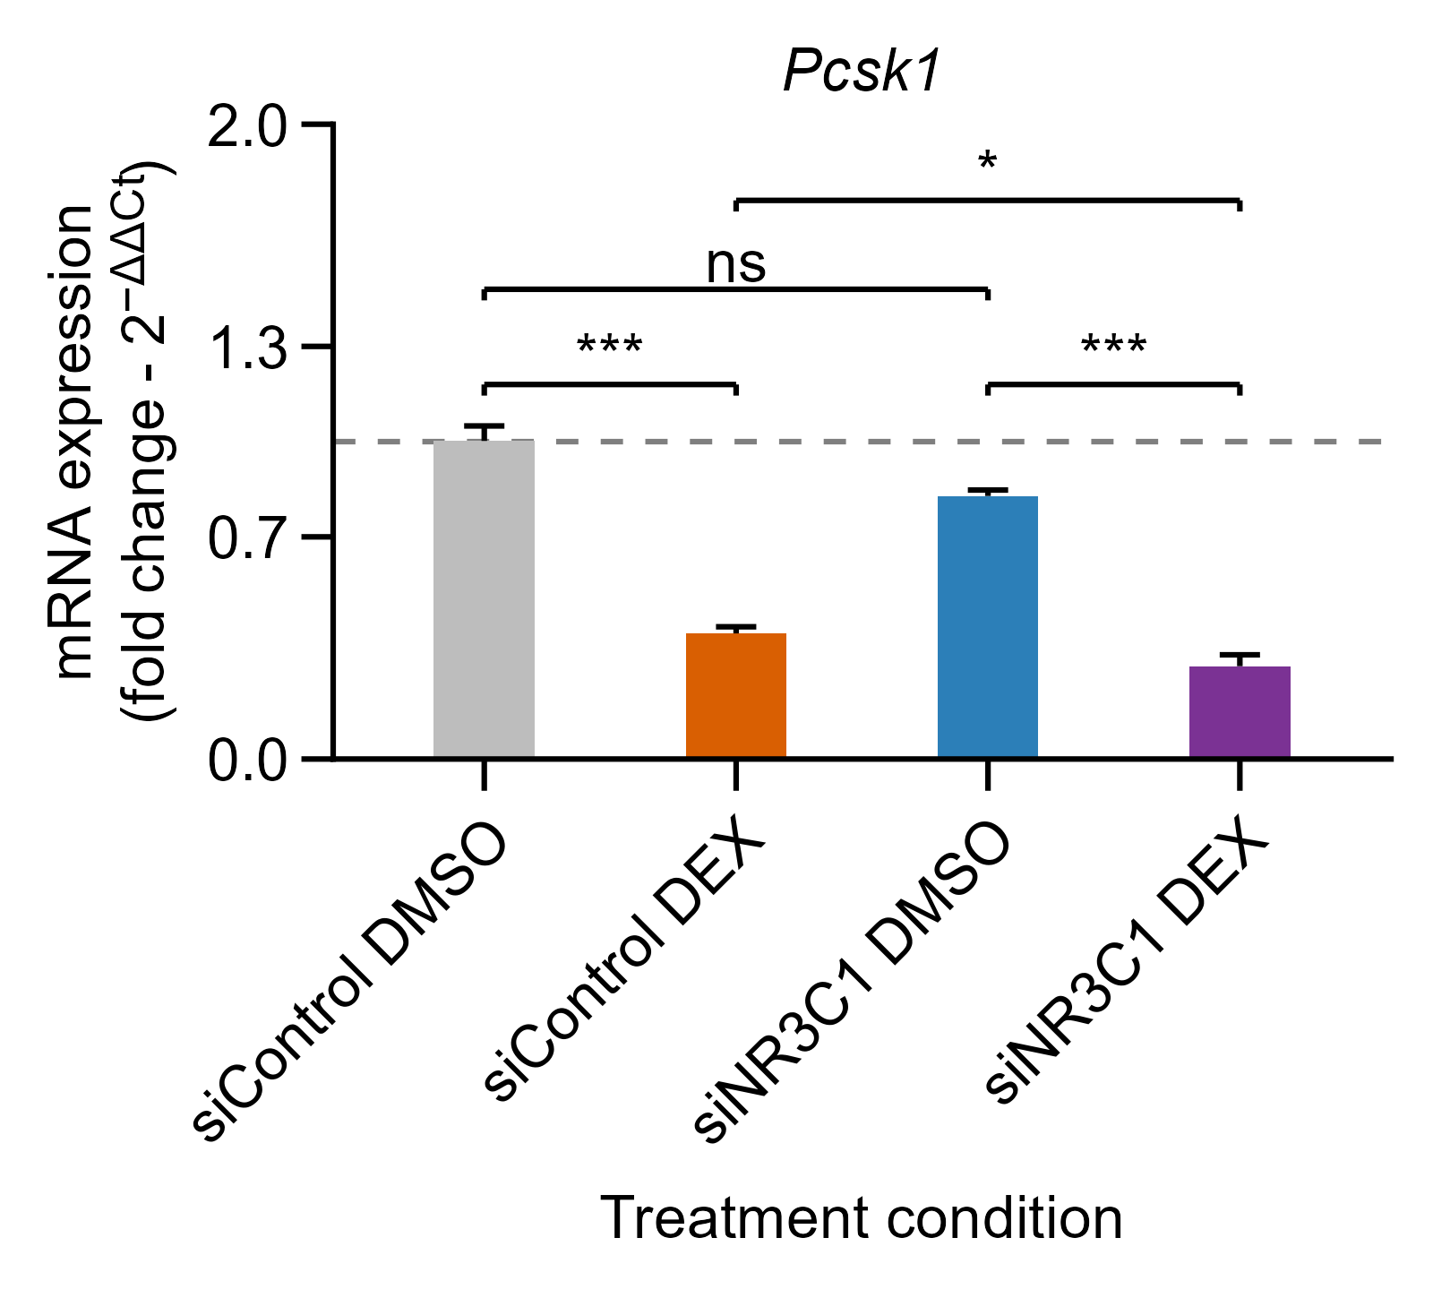
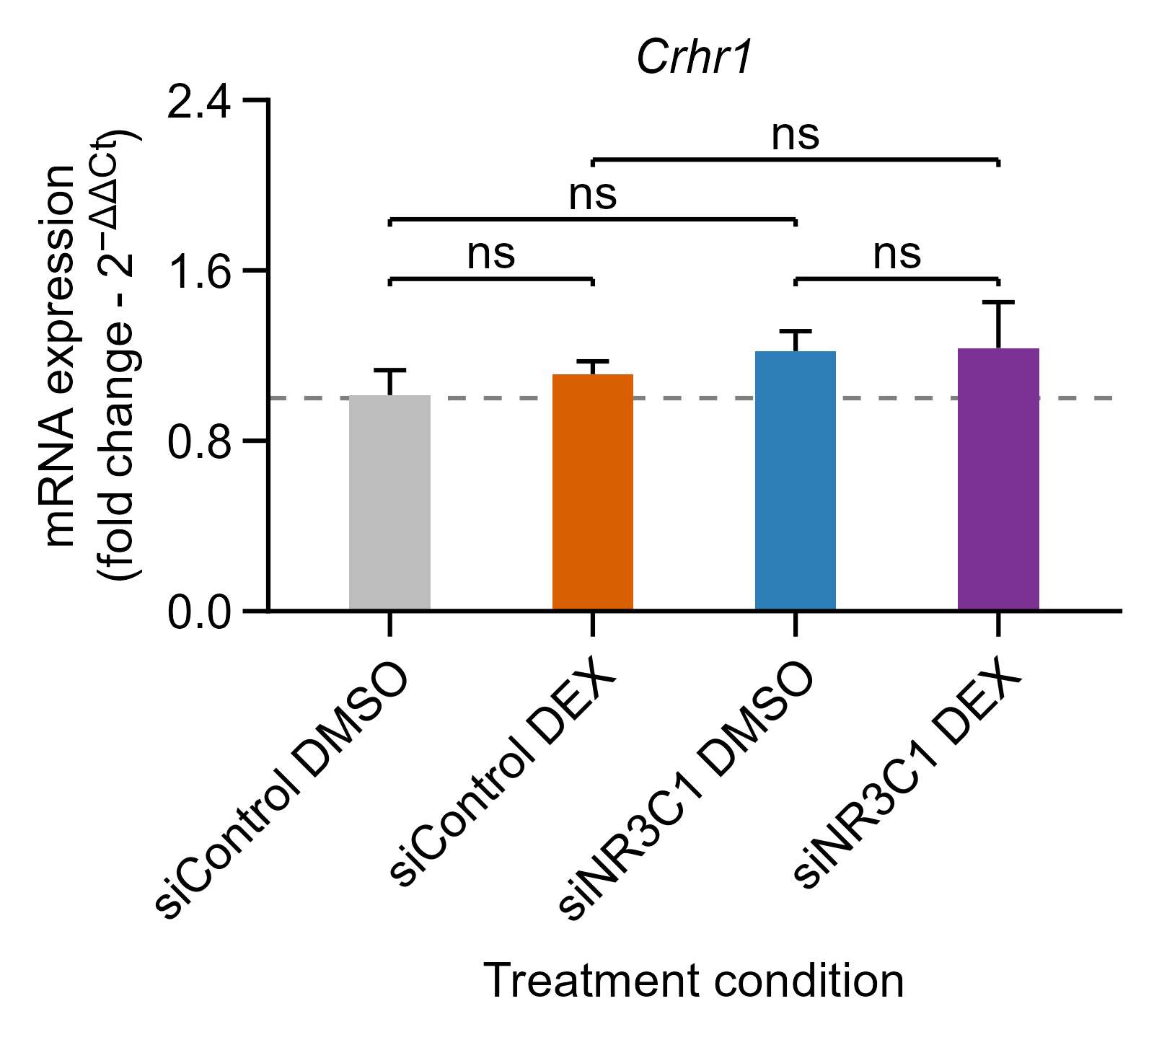
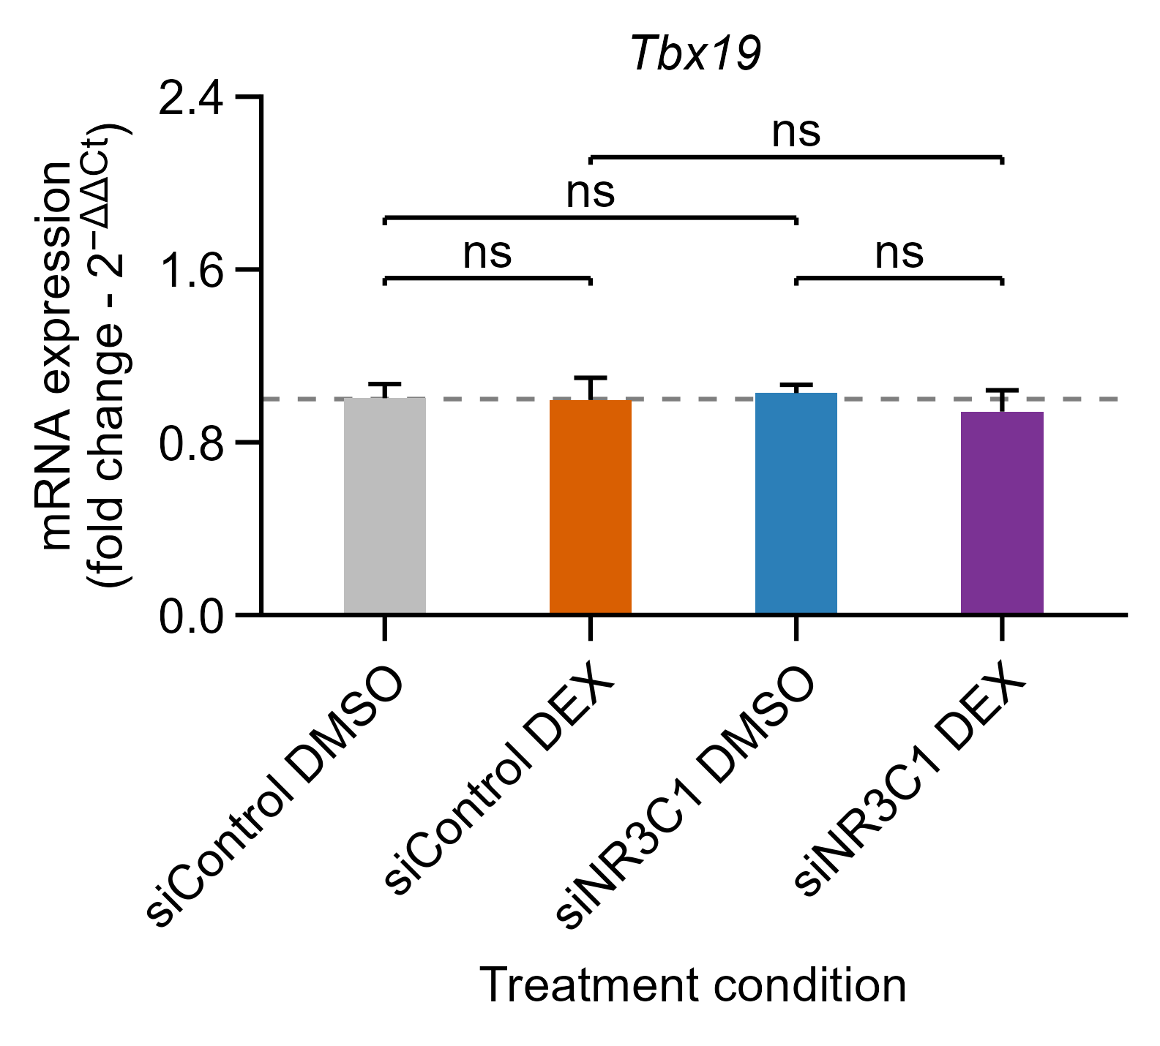
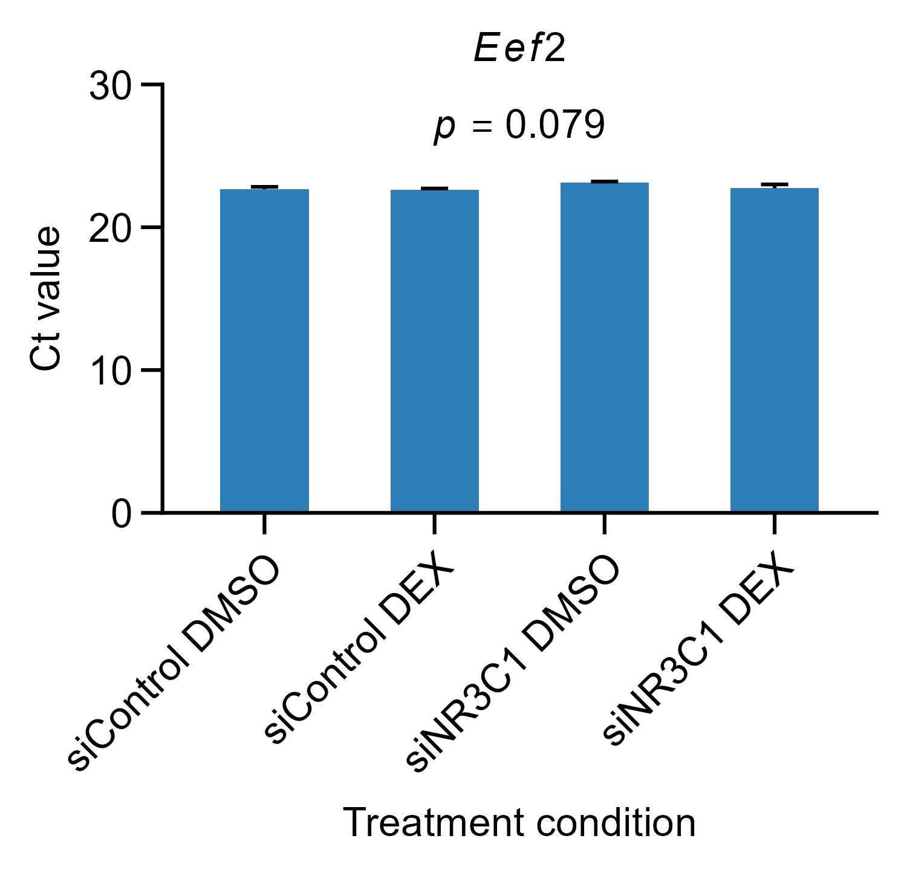
Exp.2 Silenciamiento NR3C1
18-08-2026
Figure X. Gene expression following NR3C1-targeting siRNA transfection and dexamethasone treatment in AtT-20 cells. Cells were transfected with non-targeting control siRNA (siControl) or NR3C1-targeting siRNA (siNR3C1) and subsequently treated with dexamethasone (DEX; 100 nM) or vehicle (0.1% DMSO) for 24 h. Relative mRNA expression of Crhr1, Fkbp5, Nr3c1, Pcsk1, Pomc, and Tbx19 was measured by RT-qPCR, normalized to Eef2, and calculated using the 2^−ΔΔCt method, with siControl + DMSO as the calibrator. Bars represent mean ± SEM from three independent experiments (n = 3); the dashed line indicates a fold change of 1. Statistical analyses were performed on ΔCt values using a factorial linear model including siRNA, DEX, their interaction, and experimental batch as a blocking factor. Four planned comparisons were evaluated for each gene: DEX versus vehicle within each siRNA group and siNR3C1 versus siControl within each treatment. P values were adjusted jointly across these four comparisons using Holm’s method for each gene. Brackets indicate the comparisons tested: ns, not significant; *P < 0.05; **P < 0.01; ***P < 0.001; ****P < 0.0001.
Figure X. Stability of Eef2 expression in AtT-20 cells following NR3C1 silencing and dexamethasone treatment.
Eef2 Ct values were evaluated in AtT-20 cells transfected with control siRNA (siControl) or NR3C1-targeting siRNA (siNR3C1) and subsequently treated with DMSO or dexamethasone (DEX; 100 nM) for 24 h. Data are presented as mean ± SEM from three independent biological experiments. Differences among the four experimental conditions were assessed using a linear model including experimental condition and biological replicate as a blocking factor, followed by type II ANOVA. No significant overall differences in Eef2 Ct values were detected among conditions (p = 0.079), supporting its use as the reference gene for subsequent RT-qPCR normalization.

Slide 7
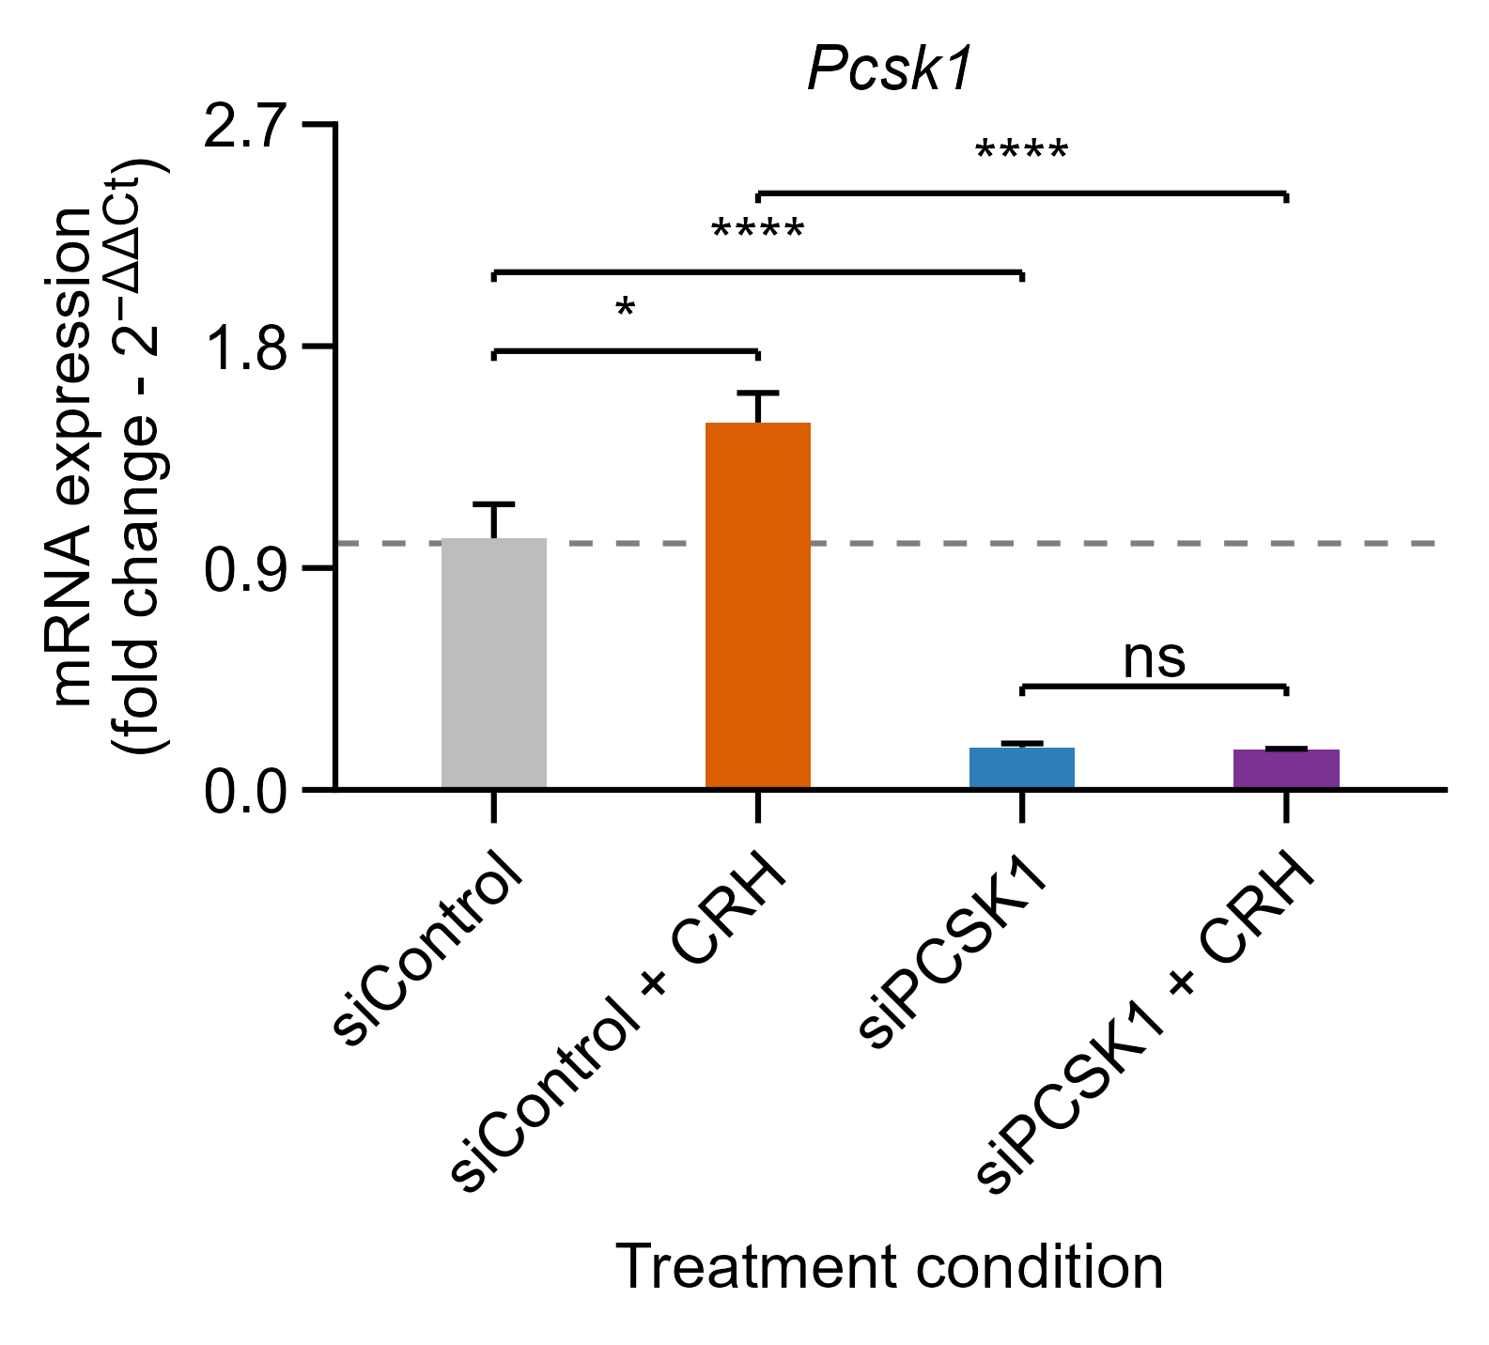
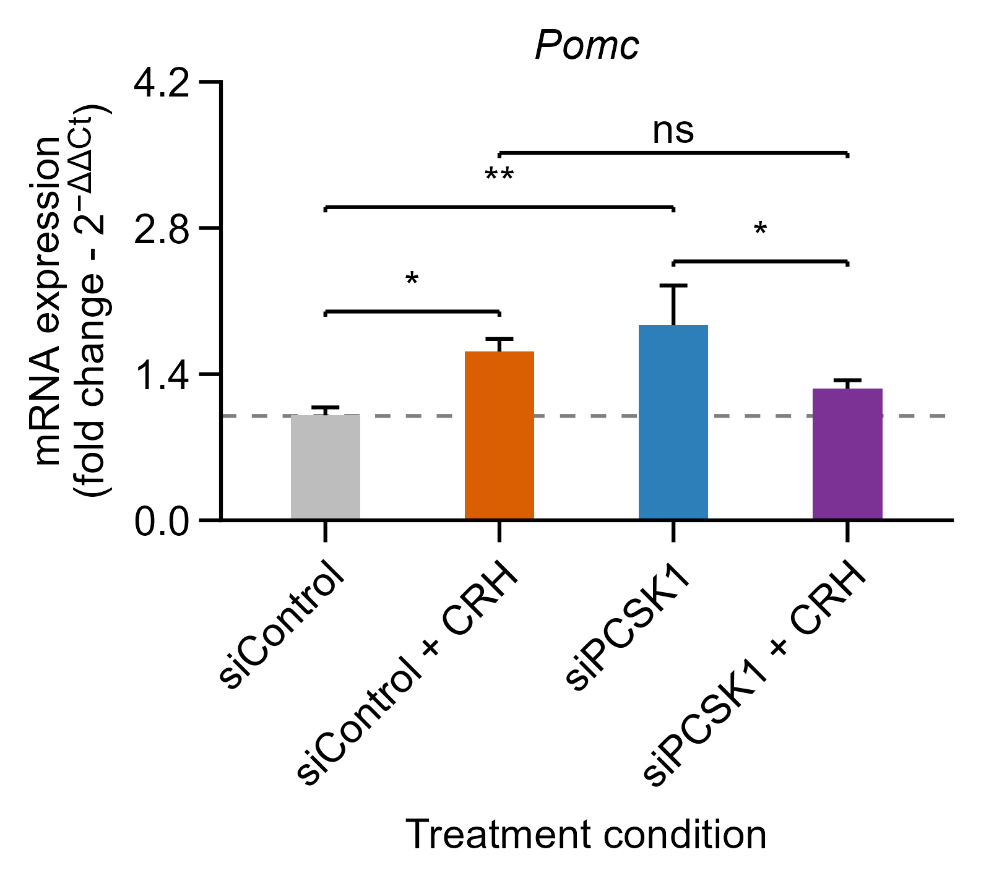
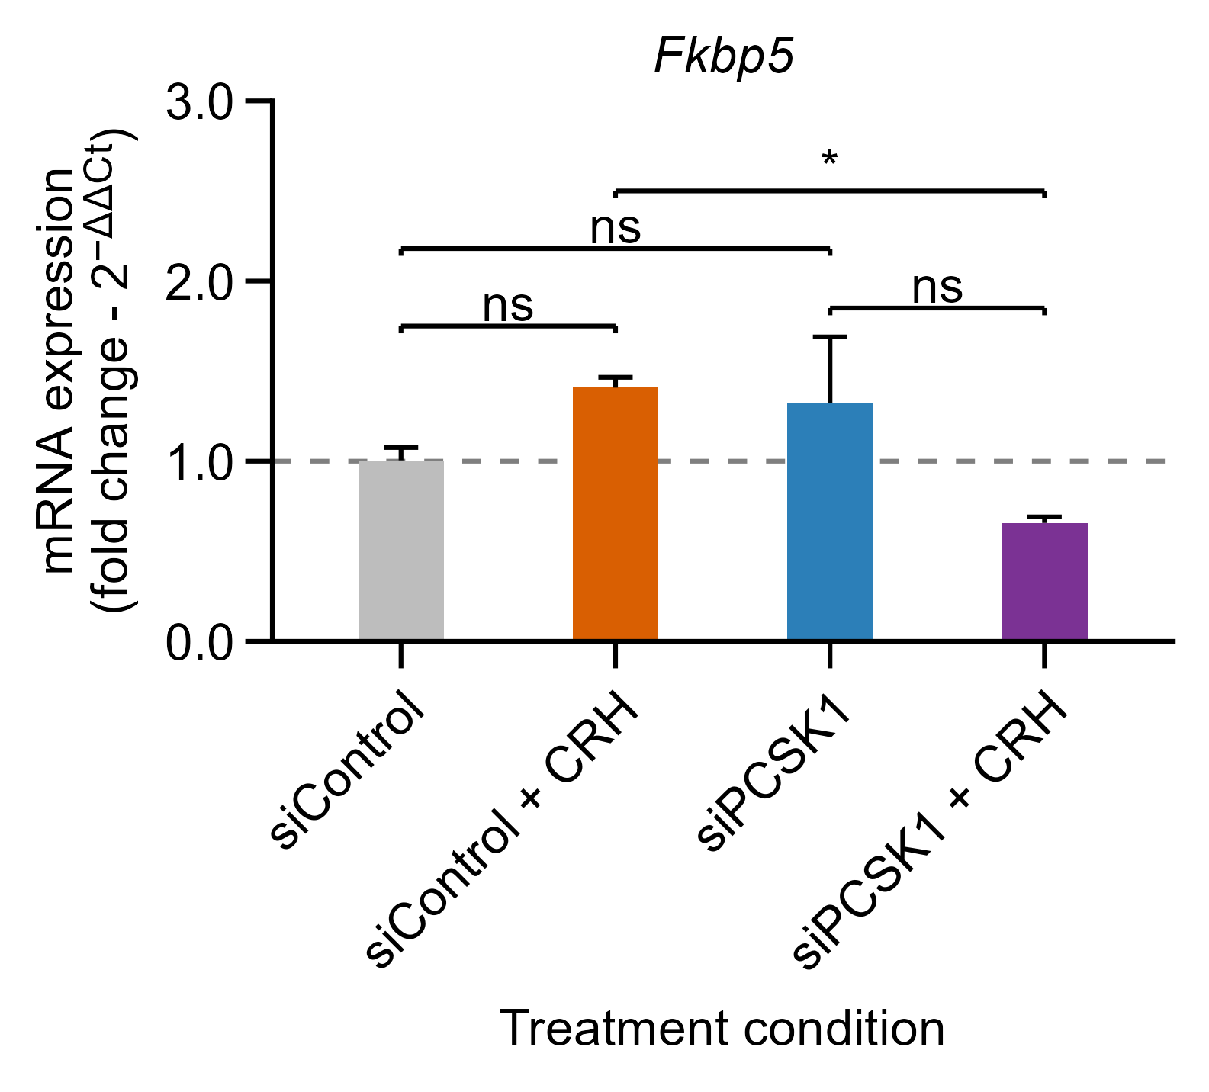
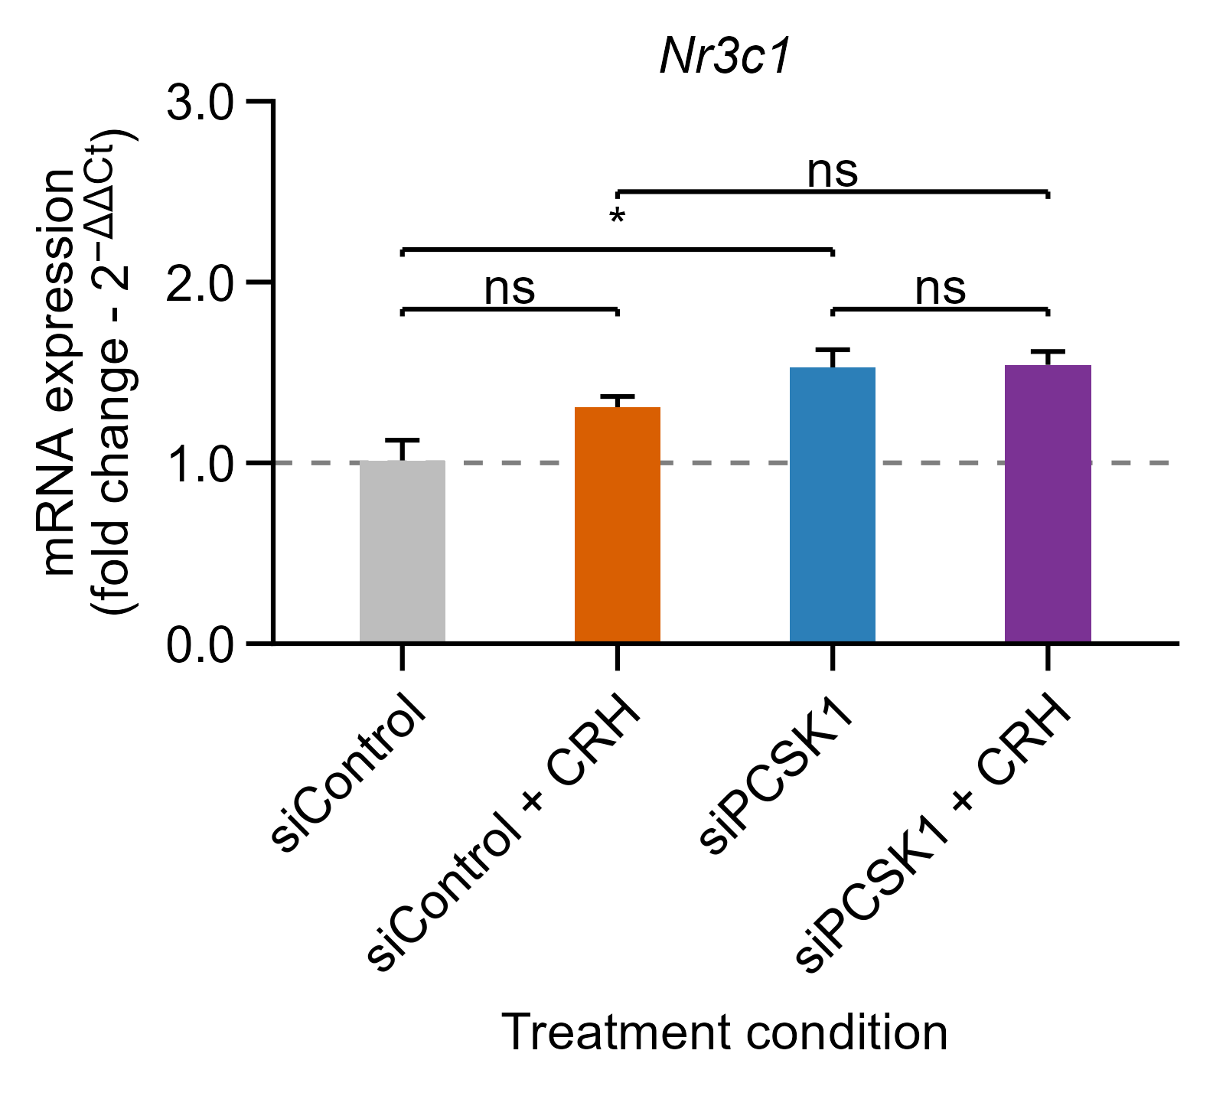
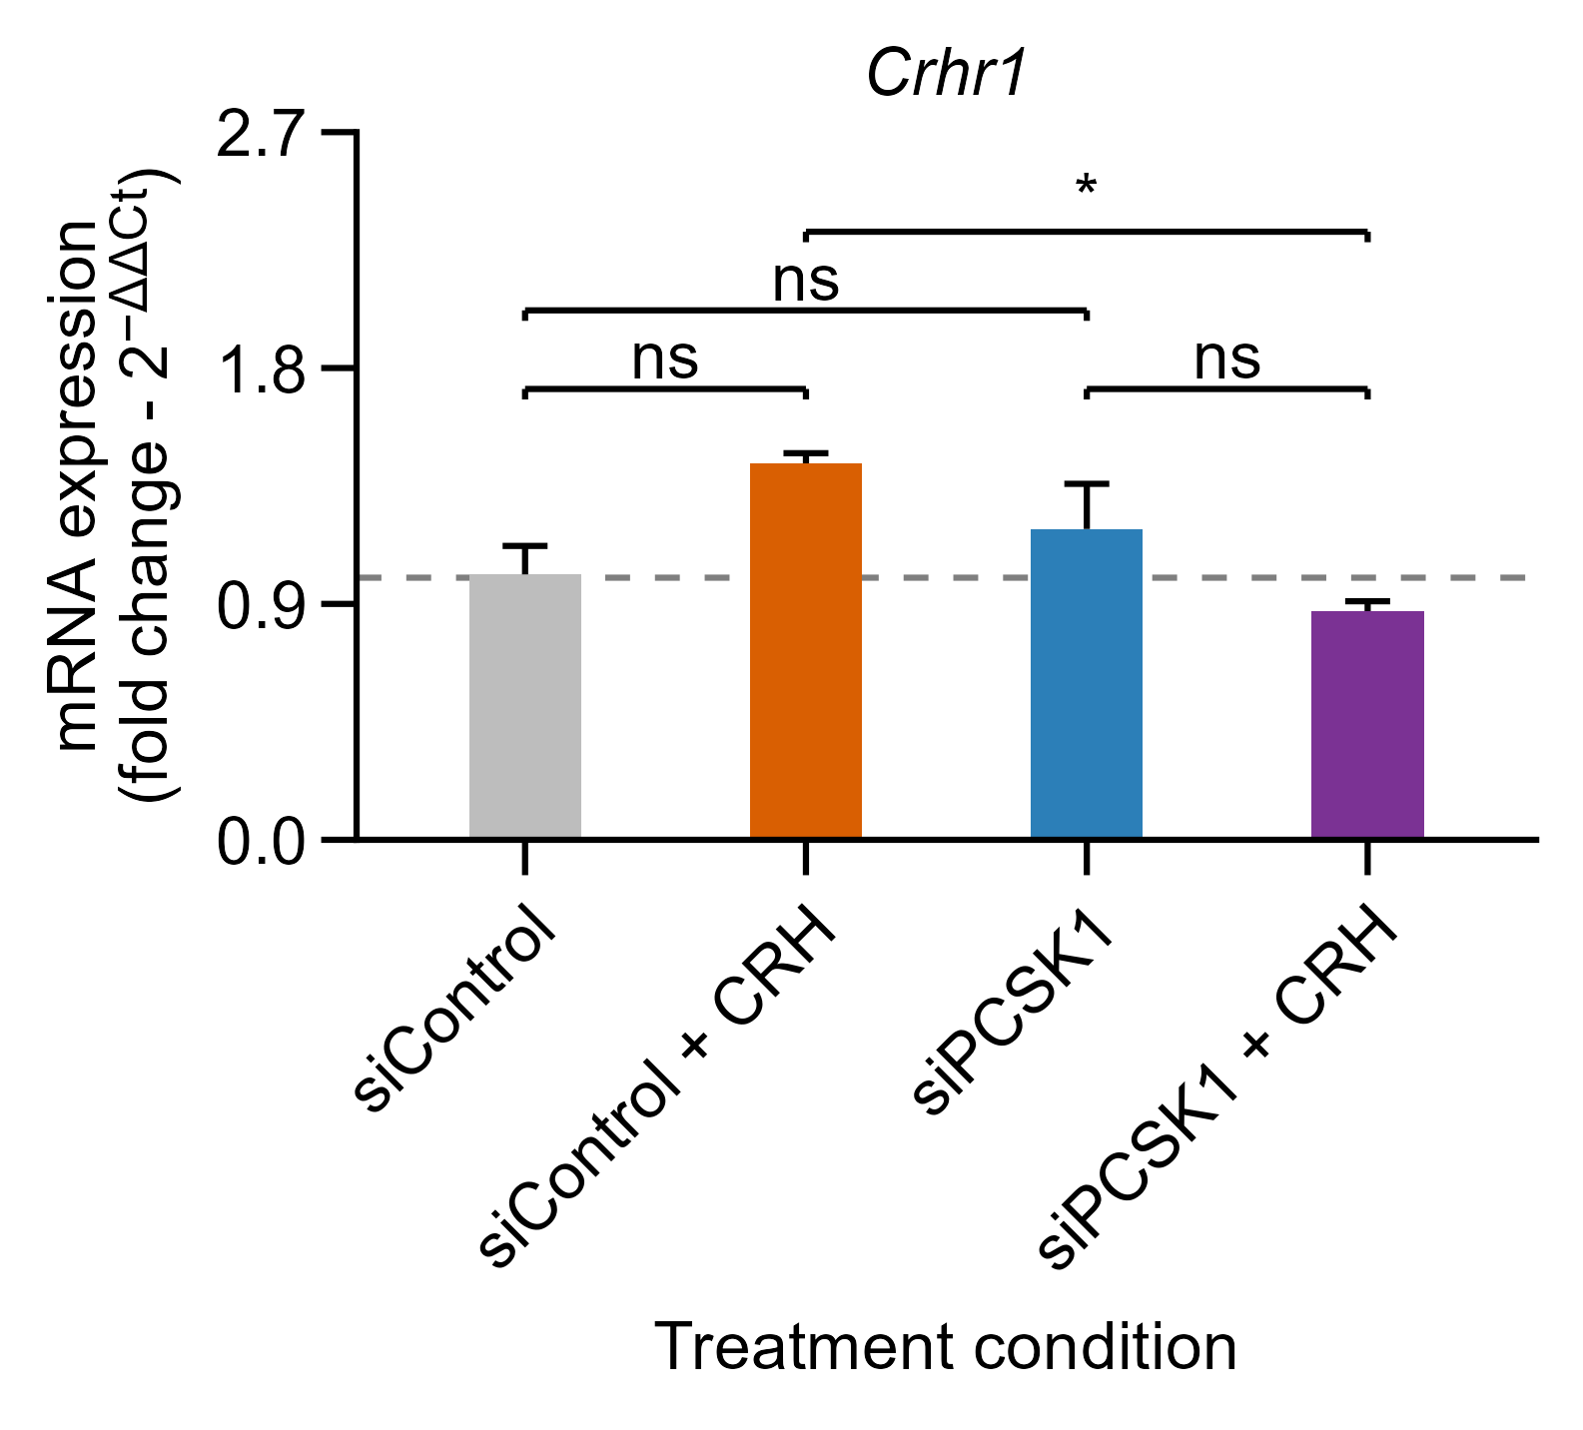
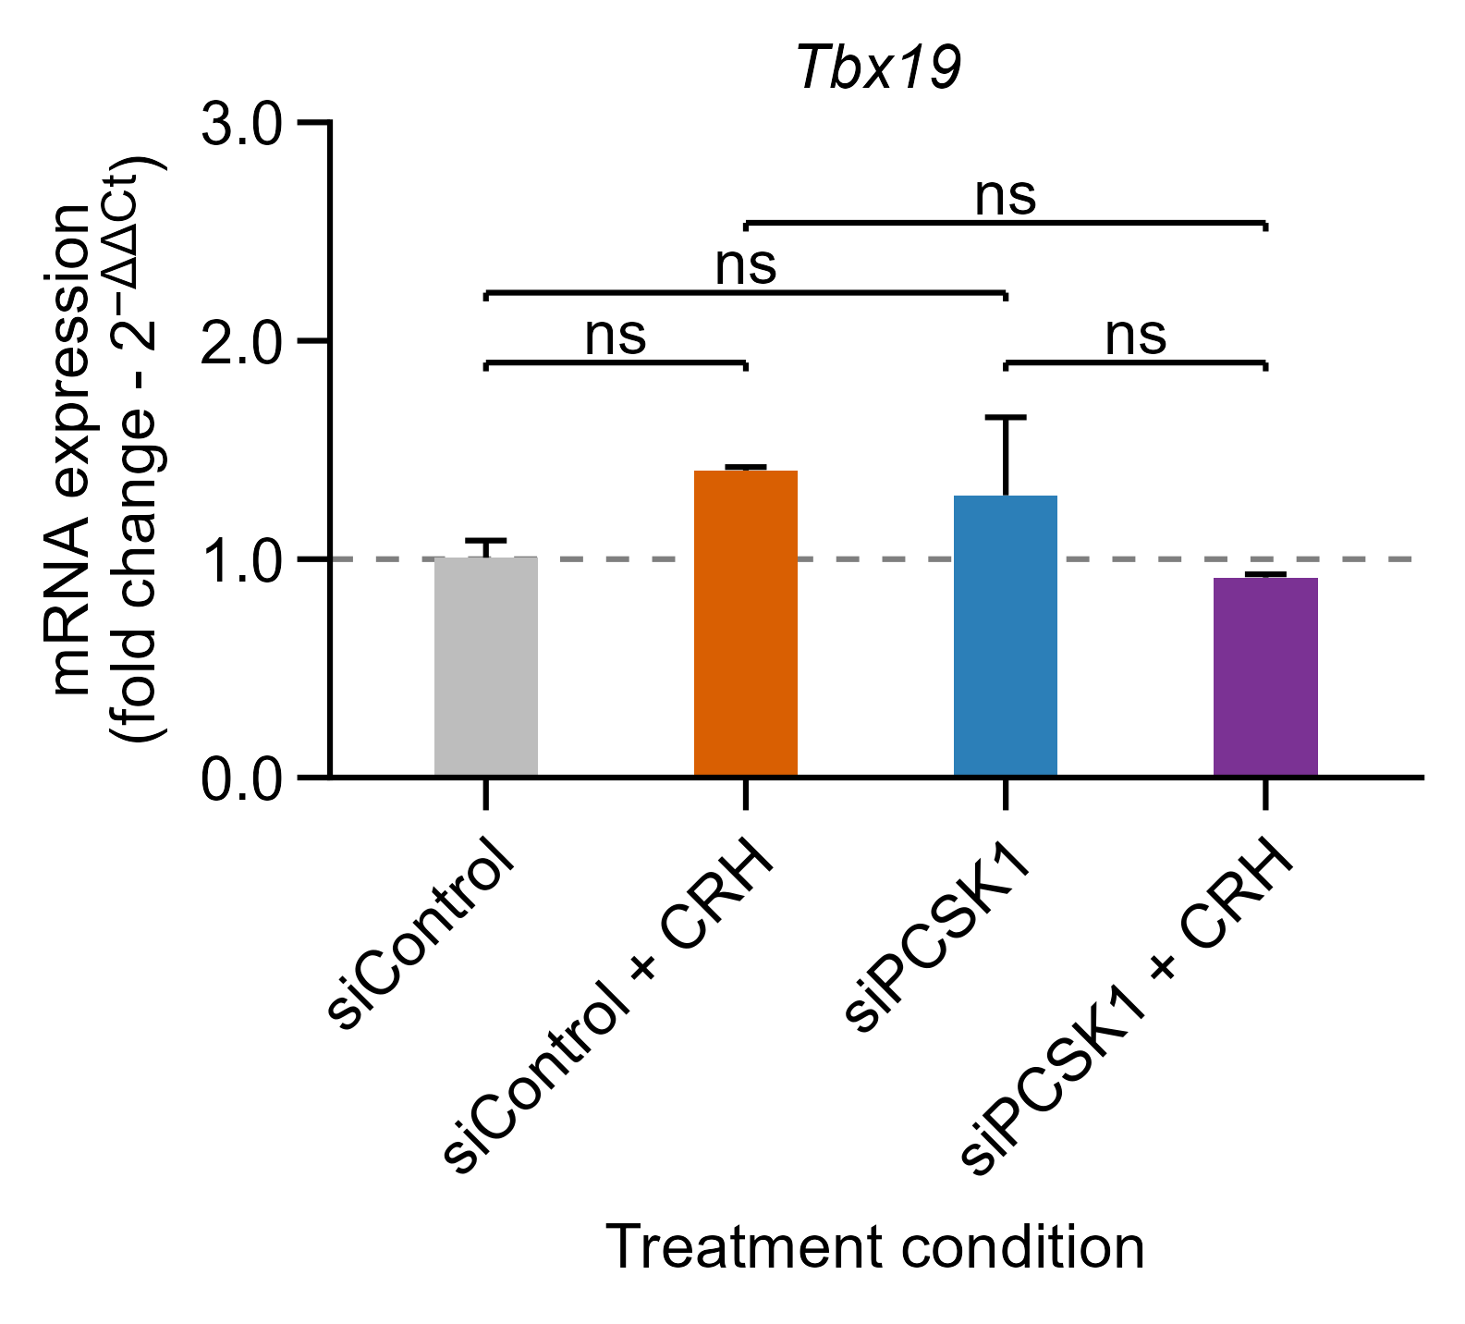
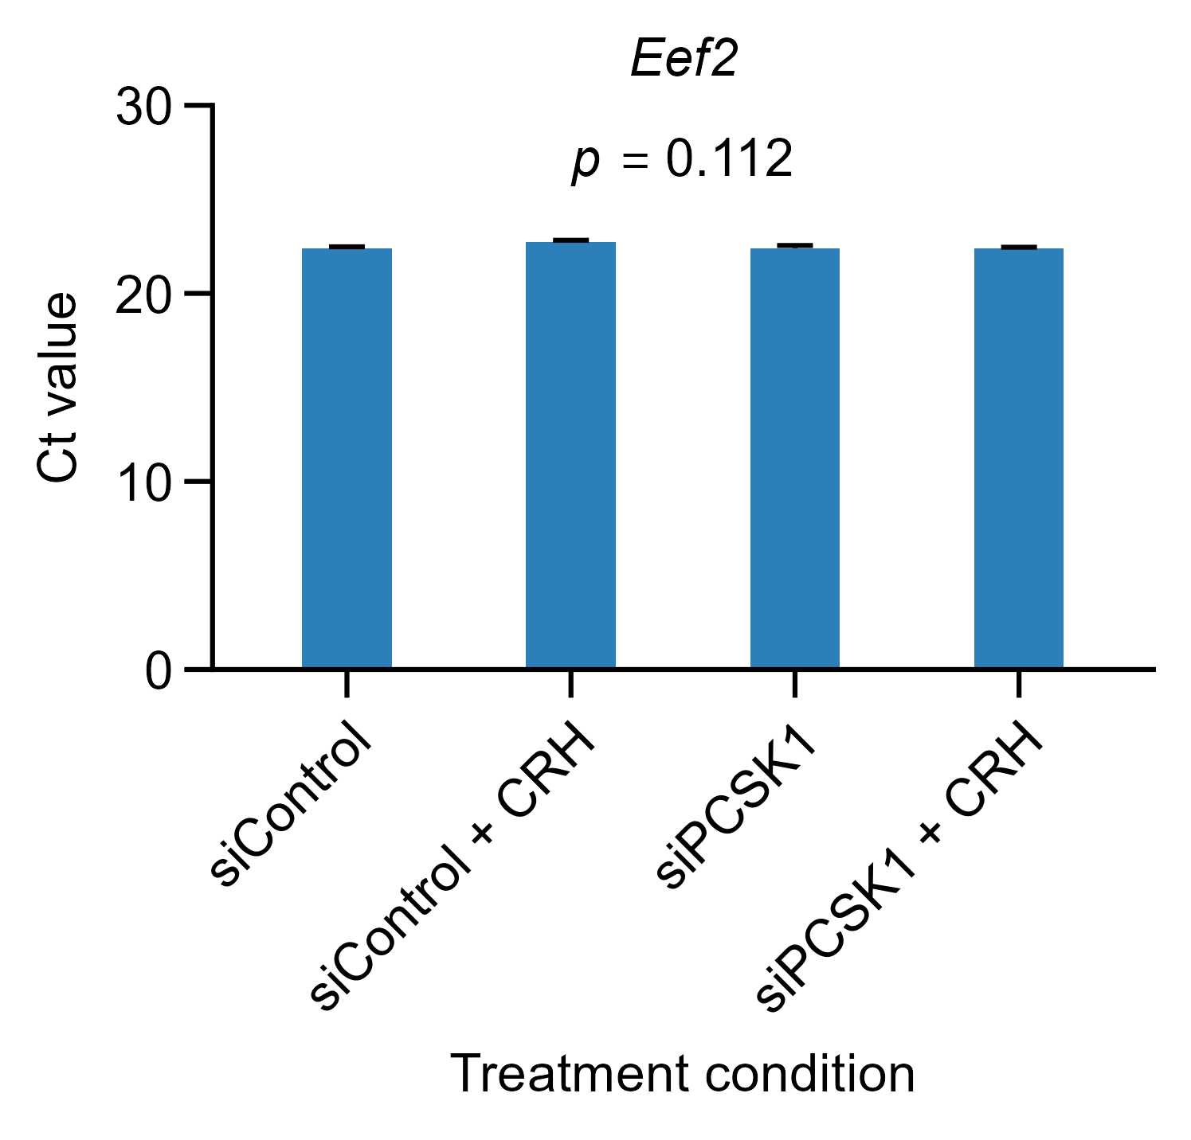
Exp.3 Silenciamiento PCSK1
18-08-2026
Figure X. Gene expression following PCSK1-targeting siRNA transfection and CRH treatment in AtT-20 cells. Cells were transfected with non-targeting control siRNA (siControl) or PCSK1-targeting siRNA (siPCSK1) and subsequently cultured in the absence or presence of CRH (10 nM) for 24 h. Relative mRNA expression of Crhr1, Fkbp5, Nr3c1, Pcsk1, Pomc, and Tbx19 was measured by RT-qPCR, normalized to Eef2, and calculated using the 2^−ΔΔCt method, with untreated siControl cells as the calibrator. Bars represent mean ± SEM from three independent biological experiments (n = 3); the dashed line indicates a fold change of 1. Statistical analyses were performed on ΔCt values using a factorial linear model including siRNA, CRH, their interaction, and biological replicate as a blocking factor. Four planned comparisons were evaluated for each gene: CRH versus untreated cells within each siRNA group, and siPCSK1 versus siControl in the absence and presence of CRH. P values were adjusted jointly across these four comparisons using Holm’s method for each gene. Brackets indicate the comparisons tested: ns, not significant; *P < 0.05; **P < 0.01; ***P < 0.001; ****P < 0.0001.
Figure X. Stability of Eef2 expression in AtT-20 cells following PCSK1 silencing and CRH treatment.
Eef2 Ct values were evaluated in AtT-20 cells transfected with control siRNA (siControl) or PCSK1-targeting siRNA (siPCSK1) and subsequently cultured in the absence or presence of CRH (10 nM) for 24 h. Data are presented as mean ± SEM from three independent biological experiments. Differences among the four experimental conditions were assessed using a linear model including experimental condition and biological replicate as a blocking factor, followed by type II ANOVA. No significant overall differences in Eef2 Ct values were detected among conditions (p = 0.112), supporting its use as the reference gene for subsequent RT-qPCR normalization.

